Slide 1
Samsung
Innovation
Campus
Artificial Intelligence Course

Slide 2
Chapter 1.
Introduction to Artificial Intelligence
AI Course

Slide 3
Chapter Description
Chapter objectives
Understand the concepts of artificial intelligence and machine learning, and learn about the types, procedures, and limitations of machine learning-based data analyses.
Be able to analyze the internal and external environment of artificial intelligence-based corporations. And be able to analyze the commercialize business models for expanding the scope of artificial intelligence service applications in artificial intelligence-based industries.
Be able to analyze trends in artificial intelligence-related technologies and changes in market demand.
Learn about the entire artificial intelligence course roadmap.
Chapter contents
Unit 1. The Concept of Artificial Intelligence
Unit 2. Applications of Artificial Intelligence
Unit 3. Techniques in Artificial Intelligence
Unit 4. Artificial Intelligence: Trends and Markets
Unit 5. Course Roadmap
Notes:
The objectives of this chapter are to set the goal of AI service for providing appropriate services by realizing a system for the works that can be done by human intelligence and to establish practical plans regarding the AI service model and scenario through the analysis of customer requirement.

Slide 4
Unit 1.
The Concept of Artificial Intelligence
1.1. Definition of Artificial Intelligence
1.2. Types and Subsets of Artificial Intelligence
1.3. Definition of Machine Learning
1.4. Disciplines Related to Machine Learning
1.5. Types and Choices of Machine Learning-based Data Analysis
1.6. Procedures for Machine Learning-based Data Analysis
1.7. Reasons For Machine Learning
1.8. Limitations of Machine Learning

Slide 5
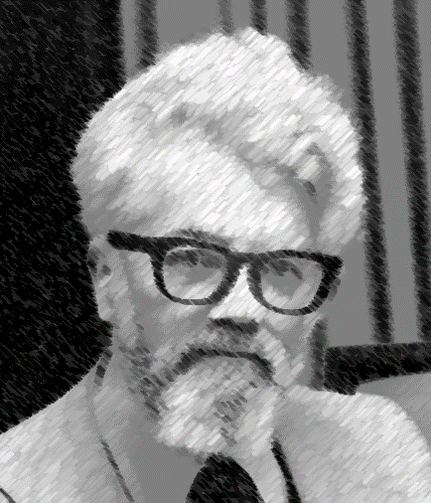
1.1. Definition of Artificial Intelligence
UNIT 01
What is Artificial Intelligence
Definition
Artificial intelligence (AI) is the ability of a computer program or a machine to think and learn. It is also a field of study that tries to make computers "smart." They work on their own without being encoded with commands. John McCarthy came up with the name "artificial intelligence" in 1955.
These processes include learning (the acquisition of information and rules for using the information), reasoning (using rules to reach approximate or definite conclusions), and self-correction.
https://www.wired.com/2011/10/john-mccarthy-father-of-ai-and-lisp-dies-at-84/
John McCarthy(1927–2011)
Notes:
The most important ability of AI is reasoning. Like human, AI can reason from fact to draw conclusion or implication. Prior to the emergence of AI, computer should be programmed by human to get an answer to the question. [Reference Source]
picture of John McCarthy https://www.wired.com/2011/10/john-mccarthy-father-of-ai-and-lisp-dies-at-84/
Definition of AI https://simple.m.wikipedia.org/wiki/Artificial_intelligence
Feature of AI https://searchenterpriseai.techtarget.com/definition/AI-Artificial-Intelligence
Progress of AI https://en.wikipedia.org/wiki/Progress_in_artificial_intelligence
What is AI https://en.wikipedia.org/wiki/Artificial_intelligence

Slide 6
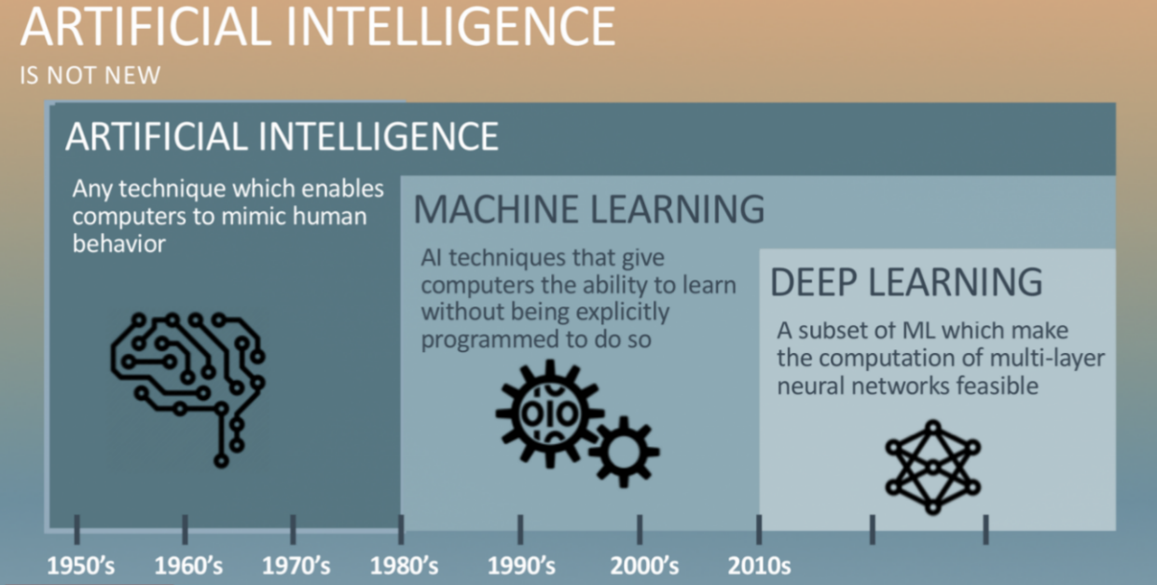
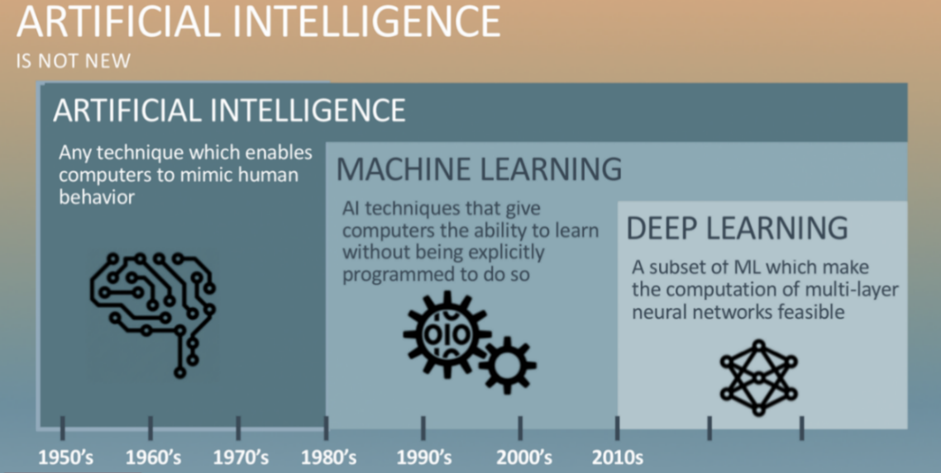

1.1. Definition of Artificial Intelligence
UNIT 01
Building an Intelligent System that Transforms Data into Knowledge
There is an abundance of structured and unstructured data in the modern tech era.
Machine learning emerged in the late 20th century as a sub-field of artificial intelligence (AI) related to self-learning algorithms that extract and predict knowledge from data.
Humans manually analyze large amounts of data to induce rules and make models.
Machine learning can gradually improve predictive models and data-based decision-making performance by extracting knowledge more efficiently from data.
ARTIFICIAL INTELLIGENCE
IS NOT NEW
ARTIFICIAL INTELLIGENCE
Any technique which enables computer to mimic human behavior
MACHINE LEARNING
AI techniques that give computers the ability to learn without being explicitly programmed to do so
DEEP LEARNING
A subset of ML which make the computation of multi-layer neural networks feasible
1950’s
1960’s
1970’s
1980’s
1990’s
2000’s
2010’s

Slide 7
Unit 1.
The Concept of Artificial Intelligence
1.1. Definition of Artificial Intelligence
1.2. Types and Subsets of Artificial Intelligence
1.3. Definition of Machine Learning
1.4. Disciplines Related to Machine Learning
1.5. Types and Choices of Machine Learning-based Data Analysis
1.6. Procedures for Machine Learning-based Data Analysis
1.7. Reasons For Machine Learning
1.8. Limitations of Machine Learning

Slide 8
1.2. Types and Subsets of Artificial Intelligence
UNIT 01
Types of Artificial Intelligence
Artificial Intelligence
Artificial Narrow Intelligence (ANI)
Artificial General Intelligence (AGI)
Weak AI
Do particular functions of humans
(E.g., smart speaker, self-driving car)
Strong AI
Do anything humans can do
A type of artificial intelligence that covers specific functionality humans can do
Majority of recent technological advancement has occurred in this area
A type of artificial intelligence that can perform all the activities humans can do
Technological advancement in AGI is relatively slower than that in ANI
Main focus of this lecture and the entire course
Notes:
AI can be categorized as either weak or strong. Weak AI, also known as narrow AI, is an AI system that is designed and trained for a particular task. Virtual personal assistants, such as Apple's Siri, are a form of weak AI. Strong AI, also known as artificial general intelligence, is an AI system with generalized human cognitive abilities. When presented with an unfamiliar task, a strong AI system is able to find a solution without human intervention.
[Reference Source]
Weak AI & Strong AI https://searchenterpriseai.techtarget.com/definition/AI-Artificial-Intelligence
Future of AGI https://medium.com/syncedreview/openai-founder-short-term-agi-is-a-serious-possibility-368424f7462f
Progress of AI https://en.wikipedia.org/wiki/Progress_in_artificial_intelligence

Slide 9



1.2. Types and Subsets of Artificial Intelligence
UNIT 01
What are subsets of AI?
Subsets of Artificial Intelligence
Artificial Intelligence
Any technique that enables computers to mimic human behavior
Artificial Intelligence
Machine Learning
A subset of AI techniques that use statistical methods to enable machines to improve through experiences
Machine Learning
Deep Learning
A subset of ML that makes the computation of multi-layer neural networks feasible
Deep Learning
Source: KD Nuggets
Notes:
In the late 20th century, machine learning was invented as a subset of artificial intelligence related to the self-learning algorithm which makes prediction by extracting knowledge from data.
AI is a branch of programming which deals with a machine processing inputs and providing output by using rules that were not hardcoded and whose accuracy according to some metric along with perceived novelty from the hardcoded rules define the program’s intelligence. These artificial intelligence systems are powered by machine learning. Many of them are powered by machine learning, some of them are powered by specifically deep learning, some of them are powered by very boring things like just rules.
[Reference Source]
Deep learning Explained https://www.nvidia.com/content/dam/en-zz/Solutions/deep-learning/home/DeepLearning_eBook_FINAL.pdf
Category of AI, Machine Learning, and Deep Learning https://www.kdnuggets.com/2017/07/rapidminer-ai-machine-learning-deep-learning.html
An executive’s guide to AI https://www.mckinsey.com/business-functions/mckinsey-analytics/our-insights/an-executives-guide-to-ai
What is AI https://www.datarobot.com/wiki/artificial-intelligence/
What is AI https://medium.com/@saileshdhungana/a-simple-yet-satisfactory-definition-of-ai-f0022fa3373d
Notes from the AI frontier: Applications and value of deep learning https://www.mckinsey.com/featured-insights/artificial-intelligence/notes-from-the-ai-frontier-applications-and-value-of-deep-learning#part1
Supervised vs Unsupervised Learning: Key Differences https://www.guru99.com/supervised-vs-unsupervised-learning.html

Slide 10
Unit 1.
The Concept of Artificial Intelligence
1.1. Definition of Artificial Intelligence
1.2. Types and Subsets of Artificial Intelligence
1.3. Definition of Machine Learning
1.4. Disciplines Related to Machine Learning
1.5. Types and Choices of Machine Learning-based Data Analysis
1.6. Procedures for Machine Learning-based Data Analysis
1.7. Reasons For Machine Learning
1.8. Limitations of Machine Learning

Slide 11
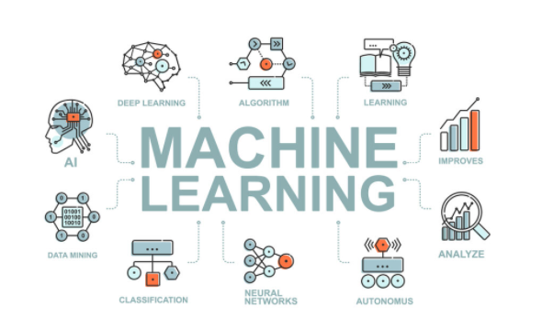
1.3. Definition of Machine Learning
UNIT 01
Definition of Machine Learning
Machine learning is a field of artificial intelligence and the study of computer algorithms that automatically improve through examples and experiences.
“A field of research that develops algorithms that allow machines to learn from data and execute actions that are not explicitly specified by code“ - Arthur Samuel, 1959
“A computer program is said to learn from experience E with respect to some class of tasks T and performance measure P if its performance at tasks in T, as measured by P, improved with experience E.“ - Tom Mitchell, 1977
DEEP LEARNING
ALGORITHM
LEARING
MACHINE
AI
LEARNING
IMPROVES
DATA MINING
ANALYZE
CLASSIFICATION
NEURAL NETWORKS
AUTONOMUS
Notes:
* Spam filter is one of the machine learning programs that use samples of spam and general mails to classify mails that are designated as spam by the user.
* Basic terms
- Training set: samples used by the system for learning
- Training instance (or sample: each training data,
· Task T classifies if the new mail is spam
· Experience E is the training data
· Performance measure P should be directly defined by the user, and performance measure is also called accuracy which is often used for classification tasks.

Slide 12
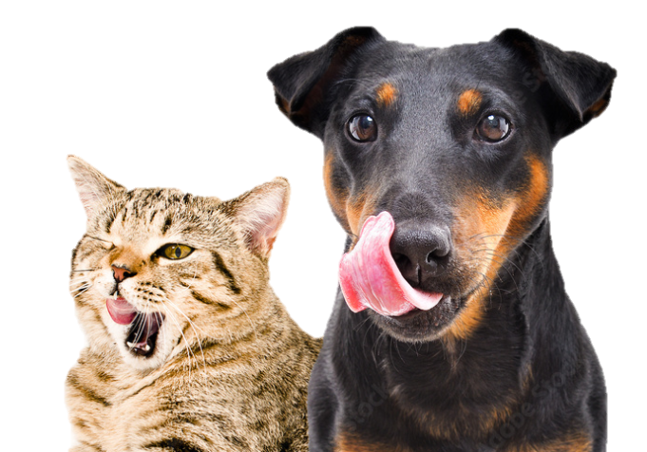
1.3. Definition of Machine Learning
UNIT 01
“A field of research that develops algorithms that allow machines to learn from data and execute actions that are not explicitly specified by code“ - Arthur Samuel, 1959
“A computer program is said to learn from experience E with respect to some class of tasks T and performance measure P if its performance at tasks in T, as measured by P, improved with experience E.“ - Tom Mitchell, 1977
The task T is to classify dogs and cats, and the performance P represents a measure of classifying dogs and cats. E can be said to be “learning” if the performance of classifying dogs and cats gradually improves through experience, or data (10,000 photos).
Notes:
People usually recognize cats and dogs based on the experience of having seen many cats and dogs overtime.
This is essentially the same to the computers. Learn from examples and recognize them later. [Reference Source]
Machine Learning & Deep Learning https://www.mathworks.com/
Machine Learning & Deep Learning Video https://www.youtube.com/watch?v=-SgkLEuhfbg&feature=youtu.be

Slide 13
Unit 1.
The Concept of Artificial Intelligence
1.1. Definition of Artificial Intelligence
1.2. Types and Subsets of Artificial Intelligence
1.3. Definition of Machine Learning
1.4. Disciplines Related to Machine Learning
1.5. Types and Choices of Machine Learning-based Data Analysis
1.6. Procedures for Machine Learning-based Data Analysis
1.7. Reasons For Machine Learning
1.8. Limitations of Machine Learning

Slide 14
1.4. Disciplines Related to Machine Learning
UNIT 01
Disciplines Related to Machine Learning
Studies Related to Machine Learning
Machine learning is an interdisciplinary study that combines academic backgrounds and achievements in various fields rather than limited to the technology or methodology in one area. These fields include probability and statistics, computer science, database theory, cognitive science, neuroscience, and pattern recognition.
Artificial Intelligence
Pattern Recognition
Statistics
Machine Learning
The Relationship Between Machine Learning and Various Disciplines
Deep Learning
Data Science
Data Mining
Computational Neuro Science
Database
Notes:
Instead of being limited to a single field of technology or methodology, machine learning is an interdisciplinary field that combines academic backgrounds and achievements in various fields such as probability and statistics, computer science, database theory, cognitive science, neuroscience, and pattern recognition, etc.
Interdisciplinary: relating to multiple academical fields.

Slide 15
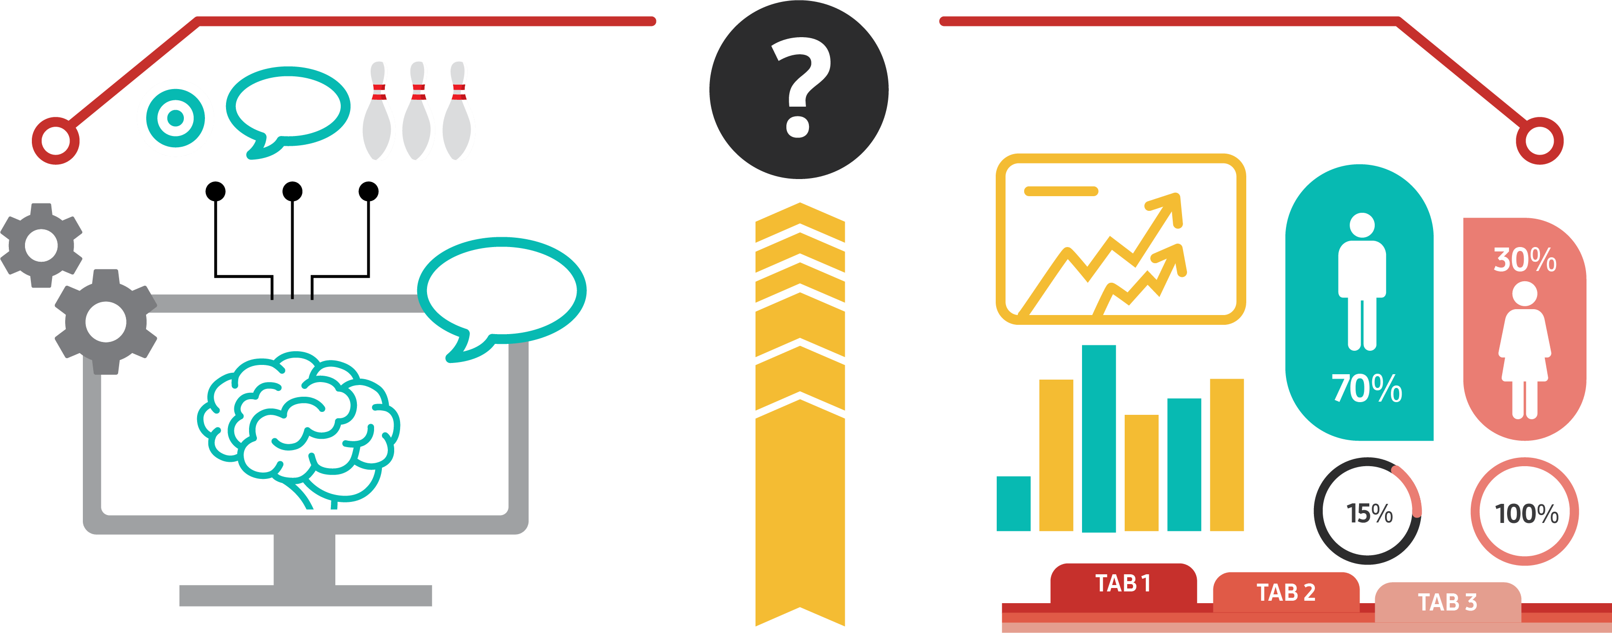
1.4. Disciplines Related to Machine Learning
UNIT 01
Machine Learning vs. Statistics
Statistics are traditionally regarded as the theoretical foundation that provides a scientific and systematic method for converting data into information. The areas particularly emphasized in statistics are inference and verification. Various methodologies and theories have been established to explain how well the given data conform to the researcher’s hypothesis and theory (or how accurately the values derived from observations estimate the actual population parameters).
Meanwhile, machine learning is mainly used to solve tasks that are difficult to design or program explicit algorithms. Most machine learning algorithms are first used to quantify complex relationships by identifying the feature of potential mechanisms generated by data and then to make predictions on new data using this identified pattern.
At first glance, the approaches of statistics and machine learning may look the complete opposite. But except for some aspects, the methodologies that form the basis of each discipline are very similar. In fact, it can be said that many methodologies of machine learning are based on statistical learning from statistics.
Machine Learning
Statistics

Slide 16
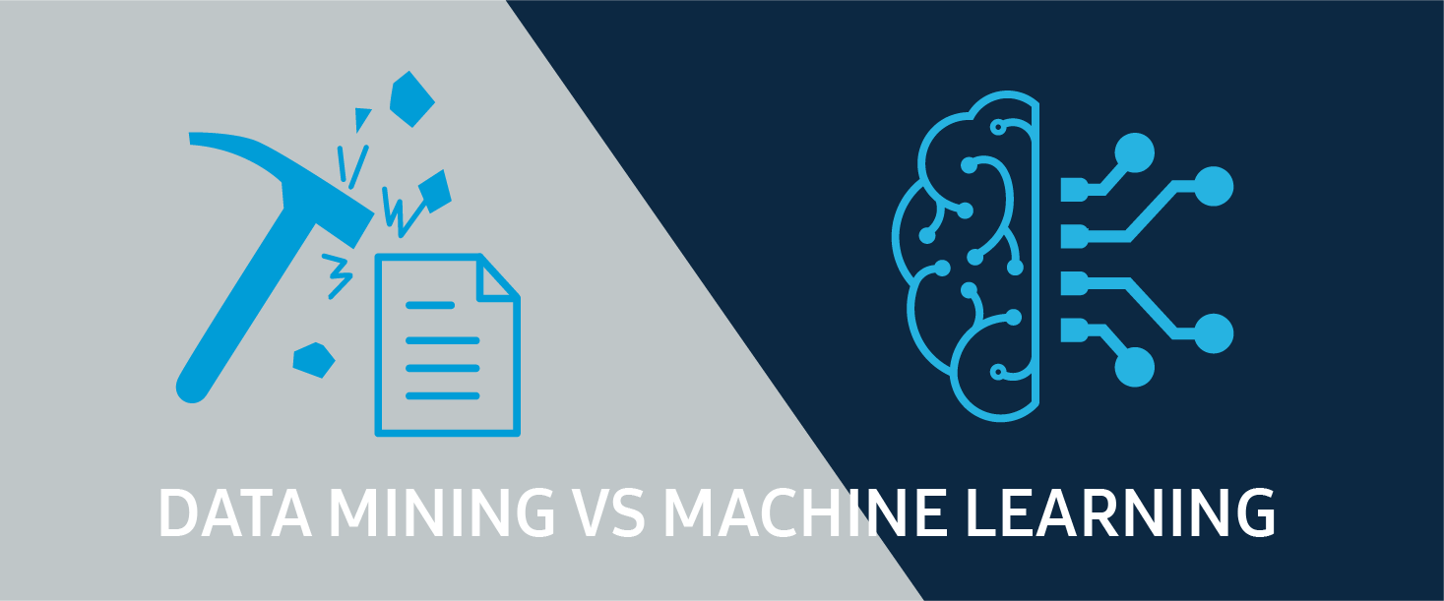
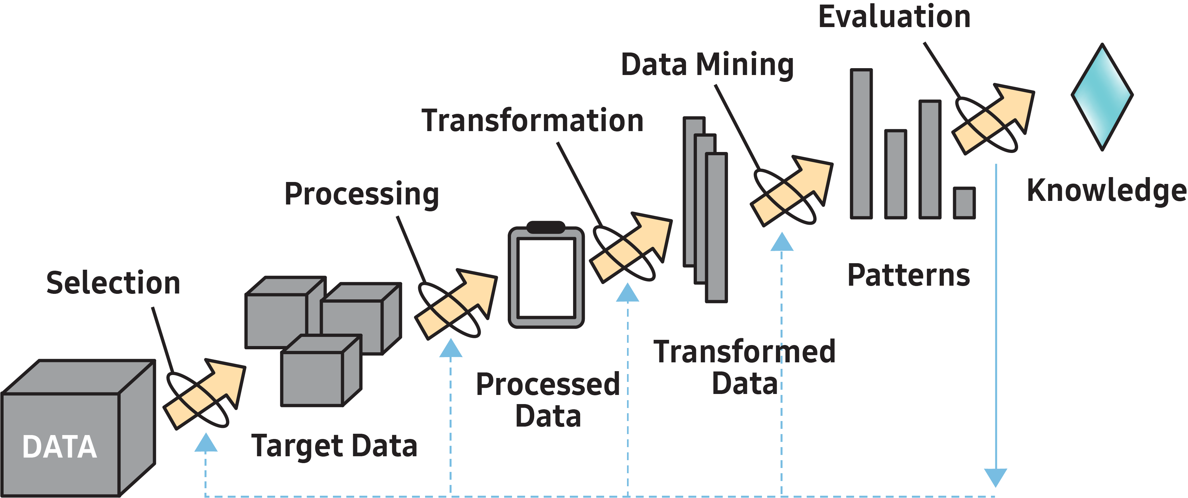
1.4. Disciplines Related to Machine Learning
UNIT 01
Machine Learning vs. Data Mining
What is Data Mining?
It refers to a process of mining useful information [gold nuggets] from a large data warehouse [stone pile].
It is a series of processes that help companies make decisions to secure competitiveness. These processes involve finding and modeling relationships, patterns, and rules between data existing in large amounts of data.
Machine learning is also deeply related to data mining because it extracts useful rules, knowledge expression, or judgment criteria from data.
Data mining is a process of systematically and automatically discovering meaningful rules or patterns within large-scale stored data and intellectualizing them. Machine learning is somehow different as it is a process in which computer programs learn, make predictions, and research and build algorithms for said process.
Notes:
[Reference Source]
Refer to the image (https://happy8earth.tistory.com/553)

Slide 17
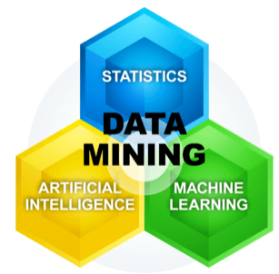
1.4. Disciplines Related to Machine Learning
UNIT 01
Statistical Analysis vs. Data Mining
Traditional Statistical Analysis
With a target group, analysis is conducted based on different assumptions on the distribution or model of a population.
→ The process of inferring the entire parameter of a population by observing a sample.
Data Mining
There are no prerequisites for the distribution or model that is inevitably involved in the sample survey or experiment.
→ The process of extracting necessary information or knowledge using the entire data of a population.
Data mining requires a large amount of data.
Notes:
Different technologies for searching data and designing a model have been present in the field of statistics over a long period of time. For instance, those technologies include linear regression, logistic regression, and principal component analysis, etc. Due to the difficult calculation and small amount of data in classical statistics, data mining in current days overcomes these limitations through enough data and outstanding computing ability to solve problems.
In mathematics and statistics, parameter refers to a variable that shows a certain characteristic of a system or function. In general, it is expressed as θ, and different signs have different meanings.

Slide 18
Unit 1.
The Concept of Artificial Intelligence
1.1. Definition of Artificial Intelligence
1.2. Types and Subsets of Artificial Intelligence
1.3. Definition of Machine Learning
1.4. Disciplines Related to Machine Learning
1.5. Types and Choices of Machine Learning-based Data Analysis
1.6. Procedures for Machine Learning-based Data Analysis
1.7. Reasons For Machine Learning
1.8. Limitations of Machine Learning

Slide 19




1.5. Types and Choices of Machine Learning-based Data Analysis
UNIT 01
Types and Choices of Machine Learning-based Data Analysis
Machine Learning vs. Deep Learning
Machine Learning Workflow
Training Data
Feature Extraction
Machine Learning
Model Classification
Test Data
Cat
Dog
Parrot
Cat
IMAGES
FEATURES
MACHINE LEARNING
WHAT THE OBJECT IS
MathWorks
Notes:
In standard machine learning methodology, a user prepares for training data set and extracts relevant features such as edges and corners to train the model.
Then, the model references the features to classify new objects. This is an example of object recognition and how computers distinguish cats and dogs with a significant level of accuracy.
[Reference Source]
Machine Learning & Deep Learning Video https://www.youtube.com/watch?v=-SgkLEuhfbg&feature=youtu.be

Slide 20



1.5. Types and Choices of Machine Learning-based Data Analysis
UNIT 01
Machine Learning vs. Deep Learning
Deep Learning Workflow
Neuron
Big mathematical equation
Cat
Neural networks were initially inspired by the brain, but the details of how they work are almost completely unrelated to how biological brains work.
(Artificial) Neural Network
MathWorks, Coursera
Notes:
On the other hand, in deep learning, a user does not need to extract features to feed images into the model, and rather inputs images themselves directly into the deep learning model.
Deep learning model basically consist of ARTIFICIAL NEURAL NETWORK algorithm which learns by itself to predict the object. Deep learning is a subtype of machine learning and usually more complex than machine learning techniques. The key difference between machine learning and deep learning is whether the model uses ARTIFICIAL NEURAL NETWORK or not. [Reference Source]
Definition of Deep learning https://en.wikipedia.org/wiki/Deep_learning

Slide 21
1.5. Types and Choices of Machine Learning-based Data Analysis
UNIT 01
Types of Machine Learning-based Data Analysis
When analyzing a large amount of data with machine learning technology, patterns that were invisible outwardly can be found, called data mining. Data mining deals with the following four problems.
Prediction
Making a model based on a given data, then applying the model to new cases for predictions
Clustering
Comparing the properties of the data and forming clusters based on similar characteristics
Predicting the quality specifications from ingredients and environment (pressure, temperature, humidity, etc.) in the fishing industry
Ex
Clusterization of processes with similar characteristics out of various processes
Ex
Data Mining
Problems
Supervised
Unsupervised
Association Rule
Identifying the attributes or relationships between items to which the appearance of a pattern implies the appearance of another pattern
Classification
Determining where a particular case belongs in a given series of classified categories
Quality Ratings from good/normal/bad, Determining the quality of new products
Ex
Predicting what will happen to the entire process when there is an abnormal pattern in one process
Ex
Notes:
There can be many different criteria to classify machine-learning based data analysis method depending on different perspectives, but in general, it is classified into supervised learning and unsupervised learning depending on the presence of objective variables (or response variables, output target value), and it is also further classified into reinforced learning and semi-supervised learning, etc.

Slide 22
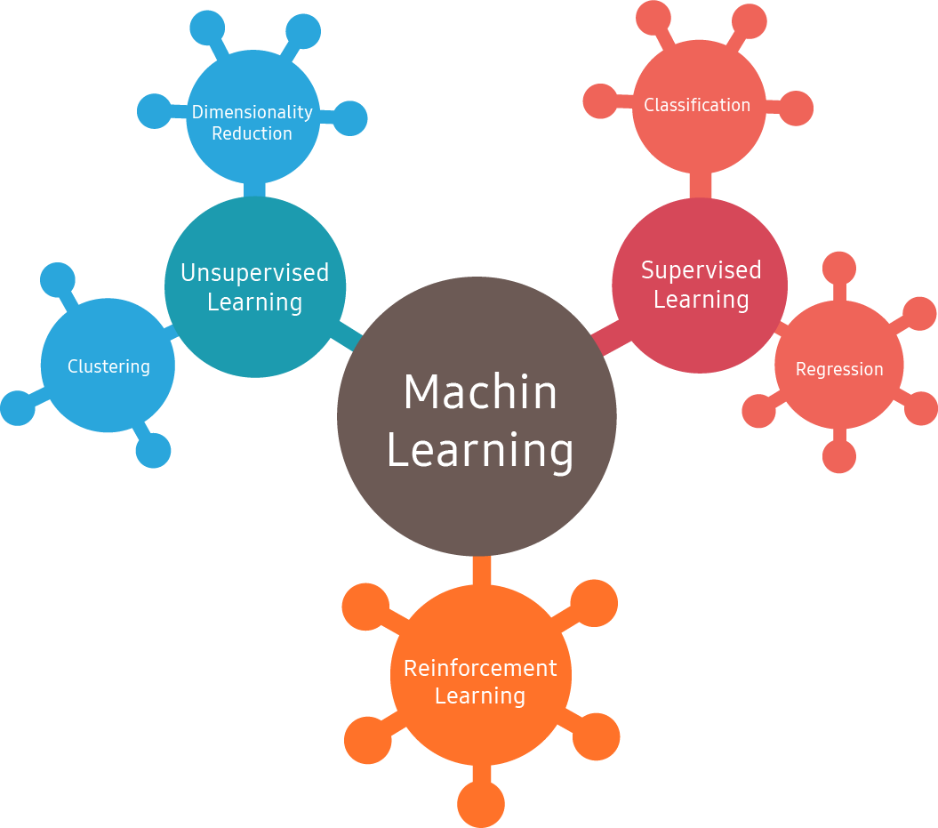
1.5. Types and Choices of Machine Learning-based Data Analysis
UNIT 01
Types of Machine Learning-based Data Analysis
There are various criteria and perspectives for classifying machine learning-based data analysis techniques. But in general, they are classified into supervised learning and self-learning (or unsupervised learning), depending on the existence of objective variables (or response variables, output target values, etc.). They can also be classified as reinforcement learning and semi-supervised learning.
Big data
Supervised Learning
Machine
Regression
Customer Segmentation

Slide 23







1.5. Types and Choices of Machine Learning-based Data Analysis
UNIT 01
Supervised Learning
Supervised learning focuses on expressing the relationship between explanatory variables (also known as independent variables, features, etc.) and objective variables (also known as response variables, dependent variables, target variables, output values, etc.) as well as predicting future observations. It is suitable for solving problems for recognition, classification, diagnosis, and prediction.
Main techniques in supervised learning can be reclassified into classification and numerical prediction techniques. This depends on the form of the objective variable (or response variable, dependent variable), whether it is a numerical (quantitative variable) or categorical (qualitative variable).
Labeled Training Set for Spam Classification (Example of Supervised Learning)
Training Set
Label
Sample
New Sample
The training data injected into the algorithm includes a desired answer called the label.

Slide 24
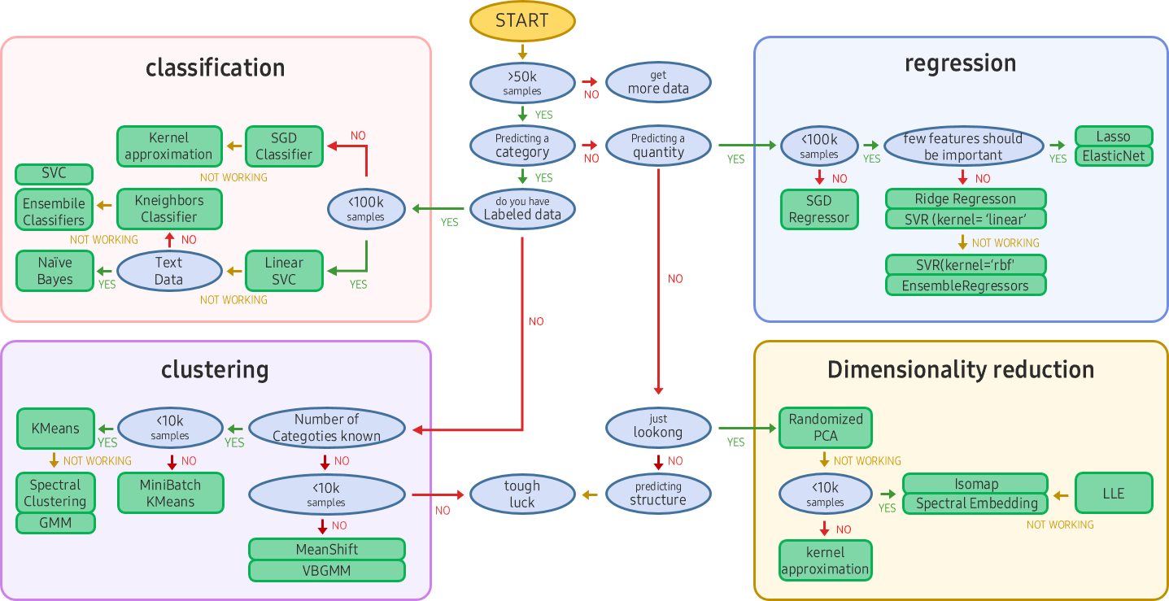
1.5. Types and Choices of Machine Learning-based Data Analysis
UNIT 01
Supervised Learning
Data mining is a combination of statistics and machine learning (or artificial intelligence). The problem to be solved by machine learning is in line with the problem of data mining.
The figure below shows a guide to solving problems with Scikit-learn, a Python module for machine learning.
kernel
approximation
Ensemble
Classifiers
labeled data
SVR (kernel=‘linear’)
SVR (kernel=‘rbf’)
number of
categories known
scikit-learn algorithm cheat-sheet
Notes:
Scikit-learn is a machine learning library created with Python.
Sometimes, the most difficult task in solving machine learning problems is to find an estimator that is appropriate to the task.
Various kinds of estimators are suitable for different types of data and problems.
The flow chart above is designed to provide brief guidelines regarding methods to approach to the problem with the estimators to be used for the data.

Slide 25
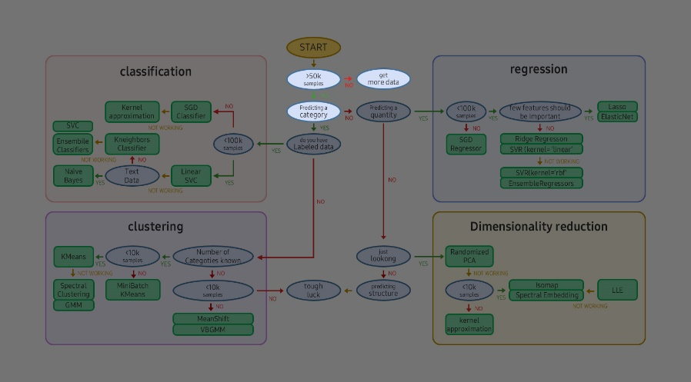
1.5. Types and Choices of Machine Learning-based Data Analysis
UNIT 01
In the Case of Insufficient Data
Looking at the figure below, statistics-based analysis is inevitable when there is a small amount of data.
In statistics, at least 30 samples are needed to estimate the population’s features (parameters).
As the number of samples increases, they become closer to the parameters.
Some assumptions can be made based on approximately 30 data. The assumption is that if there are more than 30 samples, the data will be normally distributed based on the law of large numbers.
In data mining or machine learning, a large amount of data (100,000 or more) is essential.
get
more data
No
>50
samples
YES
predicting a category

Slide 26
1.5. Types and Choices of Machine Learning-based Data Analysis
UNIT 01
Supervised Learning
See the below figure. If there is an answer among the predicted questions, and the answer is a numerical type, it is a regression. If the answer is a categorical type, it is a classification.
kernel
approximation
Ensemble
Classifiers
labeled data
SVR (kernel=‘linear’)
SVR (kernel=‘rbf’)
number of
categories known

Slide 27
1.5. Types and Choices of Machine Learning-based Data Analysis
UNIT 01
Main Techniques and Algorithms for Supervised Learning
Type | Regression (Numerical Prediction)
K-Nearest Neighbors | Linear Regression
Logistic Regression | Extended Regression Analysis (ex: Polynomial Regression, Nonlinear Regression, Penalized Regression, etc.)
Artificial Neural Network | Artificial Neural Network
Decision Tree | Decision Tree
Support Vector Machine | Support Vector Machine (Regression)
Naïve Bayes | PLS (Partial Least Squares)
Ensemble Method (Random Forest, etc.) | Ensemble Method (Random Forest, etc.)

Slide 28
1.5. Types and Choices of Machine Learning-based Data Analysis
UNIT 01
Self-Learning (or Unsupervised Learning)
Self-learning or unsupervised learning is a form in which learning is performed without information on objective variables (or response variables, dependent variables, target variables, and output values). It is mainly used for problems such as description, characteristic derivation, and pattern derivation.
In general, supervised learning techniques have clear and distinct predictive purposes. Compared to those, self-learning techniques have a stronger nature of data mining to search for useful information or patterns without prior information.
kernel
approximation
Ensemble
Classifiers
labeled data
SVR (kernel=‘linear’)
SVR (kernel=‘rbf’)
number of
categories known

Slide 29
1.5. Types and Choices of Machine Learning-based Data Analysis
UNIT 01
Unsupervised Learning
Unsupervised Learning: No label in training data, so the system must learn without any help.
Important Unsupervised Learning Algorithms
Cluster | Visualization and Dimension Reduction | Association Rule Learning
K-Means DBSCAN Hierarchical Clustering Analysis (HCA) Anomaly Detection and Outlier Detection One-Class SVM Isolation Forest | Principal Component Analysis(PCA) Kernel PCA Local Linear Embedding t-SNE | Apriori Eclat
Notes:
Typical methods of unsupervised learning include clustering, dimension reduction, association rule learning, unsupervised learning artificial neural network (SOM, etc.) and others, and the applicability of unsupervised learning methods is infinite such that the recently highlighted deep learning method also uses unsupervised learning to reduce the dimensions of input features.

Slide 30
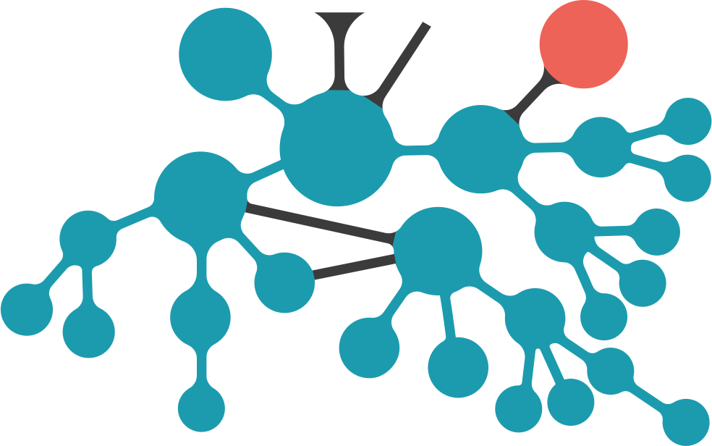
1.5. Types and Choices of Machine Learning-based Data Analysis
UNIT 01
Self-Learning (or Unsupervised Learning)
Main techniques of self-learning, or unsupervised learning, include clustering, dimensional reduction, correlation analysis, and self-learning artificial neural network (ex. SOM). They can be used for different purposes, for example, applying them in deep learning for dimension reduction of input features.
Time-series prediction
Anomaly detection
Time-series modelling
AR continuous
Unsupervised Learning
Markov chain
Latent variable models
CRF undirected
Mixed member-ship
Latent Markov -chain
HMM discrete
Dimension reduction
under complete
LDS continuous
Clique decomp.
over complete
SLDS
mixed
Latent Dirichlet Allocation
Linear
Visualis-ation
Non Linear
Factor analysis
sparse basis
NMF
PLSA
PCA

Slide 31


1.5. Types and Choices of Machine Learning-based Data Analysis
UNIT 01
Batch Learning and Online Learning
Batch Learning: The system cannot learn gradually.
Online Learning: The system is trained by sequentially injecting data one by one or in a small batch unit called a mini-batch.
Processing Large Amounts of Data Using Online Learning
Launching
많은 양의 데이터
Divide Into
Parts
A Lot of Data
Problem Research
Online Machine Learning Algorithm Training
Solution Evaluation
Error Analysis

Slide 32
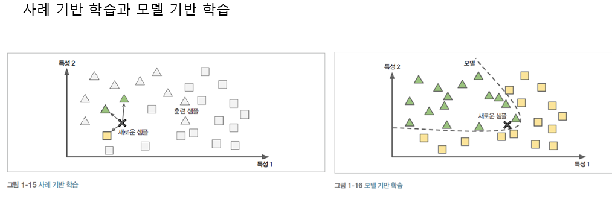
1.5. Types and Choices of Machine Learning-based Data Analysis
UNIT 01
Instance-based Learning Vs. Model-based Learning
Instance-based Learning: The system learns by remembering training samples. It is generalized by comparing new data and learned samples using similarity measurements.
Model-based Learning: The system creates a model from a sample and uses it for prediction.
Instance-based Learning
Model-based Learning
Characteristic 2
Characteristic 2
Model
Training Sample
New Sample
New Sample
Characteristic 1
Characteristic 1
Notes:
The instance based learning remembers training samples for learning and is generalized by comparing new data and learned samples using similarity measurements.
From the figure above, the new sample will be classified as triangle class, since the majority of similar samples is a triangle.
The model based learning makes a model from many samples and uses it for prediction.

Slide 33
Unit 1.
The Concept of Artificial Intelligence
1.1. Definition of Artificial Intelligence
1.2. Types and Subsets of Artificial Intelligence
1.3. Definition of Machine Learning
1.4. Disciplines Related to Machine Learning
1.5. Types and Choices of Machine Learning-based Data Analysis
1.6. Procedures for Machine Learning-based Data Analysis
1.7. Reasons For Machine Learning
1.8. Limitations of Machine Learning

Slide 34
1.6. Procedures for Machine Learning-based Data Analysis
UNIT 01
Machine Learning-based Data Analysis: Plans and Procedures
When performing machine learning-based data analysis, the following procedure is generally followed.
01. Understanding the Business and Defining the Problem
02. Collecting Data
03. Data Pre-processing and Searching
04. Data for Model Training
05. Model Performance Evaluation
06. Improving Model Performance and Market Application

Slide 35

1.6. Procedures for Machine Learning-based Data Analysis
UNIT 01
01. Understanding the Business and Defining the Problem
The top priority in machine learning-based data analysis is to define the problem to be solved.
Identify the problem by repeating the process of understanding the problem you are trying to solve, understanding the business domain, and grasping the concepts of the problem. Through repeatedly redefining the problem and finding solutions, your understanding of the specific purpose and necessary data will become clear.
Also, in the process of defining the problem and brainstorming the required data types, it naturally leads to a tentative decision-making process on which machine learning techniques will be applied.

Slide 36
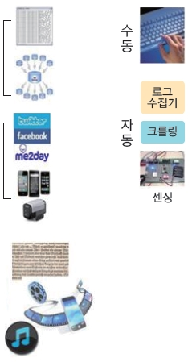
1.6. Procedures for Machine Learning-based Data Analysis
UNIT 01
02. Collecting Data
When the analysis issue is clear, necessary data must be collected.
If the data is already given, you may directly consider the appropriate analysis. But even in those cases, additional data may be generated. Collecting necessary data always needs to be considered for proper analysis.
It is common to extract data from an internal data store (data warehouse or data mart) through SQL or from a Hadoop-based big data platform. Collecting data through web scraping or API may be necessary if external data is required.
Data Source
Collecting
Internal data
Manual
Log Collector
Automated
Web Crawling
External data
Sensing
Media

Slide 37
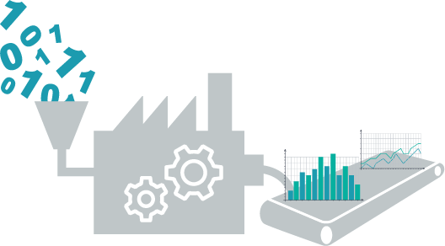
1.6. Procedures for Machine Learning-based Data Analysis
UNIT 01
03. Data Pre-Processing and Searching
When the necessary data is collected, the data is preprocessed and converted into a form suitable for machine learning. The quality of machine learning-based data analysis results depends on the required techniques or algorithms. Yet, data preprocessing, conversion, and search steps are critical as they affect the data quality.
In fact, like most analyses, this stage can take the most time and effort among machine learning-based data analysis processes.

Slide 38
1.6. Procedures for Machine Learning-based Data Analysis
UNIT 01
03. Data Pre-Processing and Searching
Standardization
Z-transform
Normalization (feature scaling)
Sampling
Random Sampling
Stratified Sampling
Cluster Sampling
Data Transformation
Normal Distribution
Log Transformation
Square Root Transformation
Dimensionality Reduction
Factor Analysis
PCA
Categorization
Discretization
Binarization
Signal Data Compression
Fourier Transform
Wavelet Transform

Slide 39
1.6. Procedures for Machine Learning-based Data Analysis
UNIT 01
03. Data Pre-Processing and Searching
Normal Distribution
Log Transform: If the input data represents an inverse function distribution, convert it to a normal distribution using a log.
Square Root Transform: Transforming non-normal distribution data into a normal distribution using square roots
Categorization
Discretization: Categorizing continuous variables into multiple sections
Binarization: Transforming into dummy variables with two values of 0 and 1
Sampling
Simple Randomization
Systematic Sampling
Stratified Randomization
Cluster Sampling
Multistage Sampling
Dimensionality Reduction
Factor Analysis: Finding common factors by finding potential variables
Principle Component Analysis

Slide 40
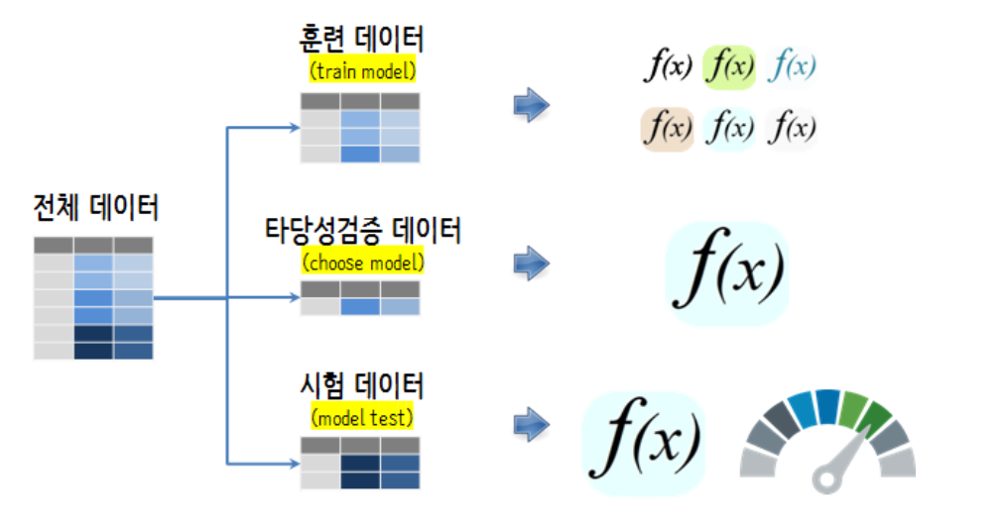
1.6. Procedures for Machine Learning-based Data Analysis
UNIT 01
04. Data for Model Training
After data preprocessing and searching, this step learns data by applying the intended machine learning technique.
In the case of supervised learning, data can be divided into learning data and verification/evaluation data for model training. Otherwise, model training can be conducted after designing for cross-validation.
In the case of self-learning (or unsupervised learning), it is a process of deriving patterns through analysis rather than model training since it does not have a target value.
train model
Entire Data
choose model
model test
Notes:
[Reference Source]
https://statkclee.github.io/ml/ml-model-selection.html

Slide 41
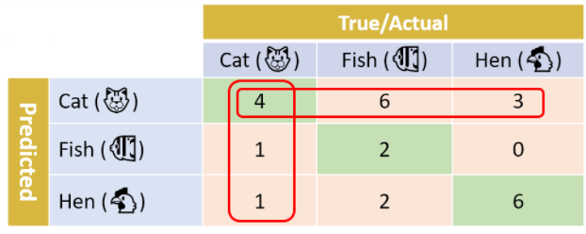



1.6. Procedures for Machine Learning-based Data Analysis
UNIT 01
05. Model Performance Evaluation
In general, machine learning-based learning models tend to produce biased results in training data. Thus, machine learning algorithms use evaluation datasets to evaluate the model’s accuracy.
In the case of self-learning, it is common not having an evaluation data set. Rather than cross-validation, performance is evaluated with the interpretation of statistics or rules derived from the analysis process.
True/Actual
Cat
Fish
Hen
Cat
4
6
3
Fish
1
2
0
Predicted
Hen
1
2
6
https://towardsdatascience.com/multi-class-metrics-made-simple-prat-i-precision-and-recall-9250280bddc2
Notes:
[Reference Source]
https://towardsdatascience.com/multi-class-metrics-made-simple-prat-i-precision-and-recall-9250280bddc2

Slide 42

1.6. Procedures for Machine Learning-based Data Analysis
UNIT 01
06. Improving Model Performance and Market Application
An issue that needs a single machine learning analysis process is rarely solved at once. The model’s performance is improved by continuously changing model parameters and prediction methods.
Sometimes, other algorithms are applied to compare the performance with the initial algorithms.
Judging model performance: The judgment on how satisfactory the model performance is can vary depending on the issue or business domain. In any case, there is no absolute criterion to judge that the model performance has improved sufficiently.
Improving model performance: Analysts should compare and apply various algorithms and change parameters and prediction methods even within the same algorithm. They need to seek to improve model performance until they are considered satisfactory.
Application of the satisfied model to the market: If the derived results satisfy the model after this process, it can be applied to the initial business issue. Additional development for automation or system linkage may be required in some cases.

Slide 43
Unit 1.
The Concept of Artificial Intelligence
1.1. Definition of Artificial Intelligence
1.2. Types and Subsets of Artificial Intelligence
1.3. Definition of Machine Learning
1.4. Disciplines Related to Machine Learning
1.5. Types and Choices of Machine Learning-based Data Analysis
1.6. Procedures for Machine Learning-based Data Analysis
1.7. Reasons For Machine Learning
1.8. Limitations of Machine Learning

Slide 44
1.7. Reasons For Machine Learning
UNIT 01
Reasons For Machine Learning
Why Use Machine Learning?
With traditional programming techniques, the rules become longer and more complex, making them very difficult to maintain. However, spam filters based on machine learning techniques detect patterns that appear more frequently in spam mail. They automatically learn which words and phrases are good criteria for judging spam.
Machine learning is suitable for fields that are too complex or have no known algorithms in traditional ways (e.g., speech recognition).
Traditional Approach
Launch!
Problem Research
Making Rules
Solution Evaluation
Error Analysis

Slide 45
1.7. Reasons For Machine Learning
UNIT 01
Strengths of Machine Learning
Problem: Existing solutions require a lot of manual adjustment and rules. ML: One machine learning model can simplify the code and increase performance compared to traditional methods.
Problem: Complex problems cannot not be solved in traditional ways. ML: Solutions can be found with the best machine learning techniques.
Fluid Environment: Machine learning systems can adapt to new data.
Gain insight from complex problems and large amounts of data.
Machine Learning Approach
Data
Launch!
Problem Research
Machine Learning Algorithm Training
Solution Evaluation
Error Analysis

Slide 46
Unit 1.
The Concept of Artificial Intelligence
1.1. Definition of Artificial Intelligence
1.2. Types and Subsets of Artificial Intelligence
1.3. Definition of Machine Learning
1.4. Disciplines Related to Machine Learning
1.5. Types and Choices of Machine Learning-based Data Analysis
1.6. Procedures for Machine Learning-based Data Analysis
1.7. Reasons For Machine Learning
1.8. Limitations of Machine Learning

Slide 47
1.8. Limitations of Machine Learning
UNIT 01
Limitations of Machine Learning
Insufficient Training Data
Most machine learning algorithms require a lot of data to work well.
Even in simple problems, thousands of data are needed, and millions of complex problems such as image or voice recognition may be needed (In the case you cannot reuse a model that has already been made).
Since collecting additional training data is not always easy or cheap, the algorithm cannot yet be ignored.
$$2^{784}$$
60000
MNIST
Rare Database in a Vast Space

Slide 48
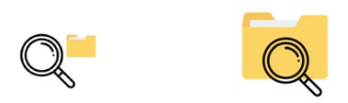
1.8. Limitations of Machine Learning
UNIT 01
Training Data Without Representation
Sampling Noise: Coincidental data without representation by chance
Sampling Bias: Very large samples are not representative when the sampling method is wrong
Sampling Noise
Sampling Bias

Slide 49
1.8. Limitations of Machine Learning
UNIT 01
Poor Quality Data
When the training data is full of errors, outliers, and noise, the machine learning system will not work well because it is difficult to find the inherent patterns.
When cleaning is needed: If it is clear that some samples are outliers, it is better to ignore or fix them.

Slide 50
1.8. Limitations of Machine Learning
UNIT 01
Irrelevant Features
The system can only learn when the features and those related to the training data are sufficient.
A vital element of a successful machine learning project is finding good features to use for training, known as feature engineering.
Feature selection: Choose the most useful feature for training
Feature extraction: Combining features creates a more useful feature (dimension reduction)

Slide 51
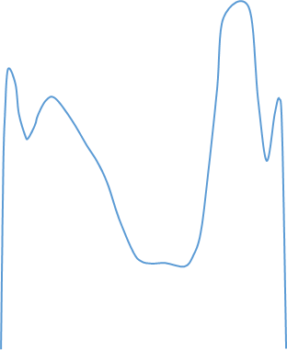

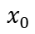
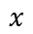
1.8. Limitations of Machine Learning
UNIT 01
Overfitting Training Data
Regularization: Putting constraints on the model to simplify it and reduce the risk of overfitting.
$$y$$
$$x$$
$$x_{0}$$
Graph of an Inaccurate Prediction Due to Overfitting

Slide 52


1.8. Limitations of Machine Learning
UNIT 01
Underfitting Training Data
Select a more powerful model with more model parameters.
Provide better features in learning algorithms (feature engineering).
Reduce model constraints (reduce the regulation hyperparameters).
$$y$$
$$x$$

Slide 53
Unit 2.
Applications of Artificial Intelligence
2.1. Applications of Artificial Intelligence
2.2. Image Recognition
2.3. Computer Vision & Machine Vision
2.4. Speech Intelligence

Slide 54


2.1. Applications of Artificial Intelligence
UNIT 02
Applications of Artificial Intelligence
Thanks to machine learning, email spam filters, convenient text and voice recognition software, reliable web search engines, and safe and efficient autonomous vehicles are available.
There has also been great progress in medical applications.
Ex
A deep learning model can diagnose skin cancer with a near-human accuracy.
Andre Esteva, et al., “Dermatologist-level classification of skin cancer with deep neural networks”, Nature, volume 542(2017), pages 115–118
https://www.nature.com/articles/nature21056
Deep learning predicted the 3D protein structure, surpassing the performance of physics-based methods for the first time.
https://deepmind.com/blog/alphafold/
Notes:
[Reference Source]
https://www.nature.com/articles/nature21056
https://deepmind.com/blog/alphafold/

Slide 55

2.1. Applications of Artificial Intelligence
UNIT 02
Machine learning plays a huge role in our daily lives and will become increasingly important. The following are the various applications of artificial intelligence.
Planning
Expert Systems
Robotics
Speech to text
Image Recognition
Speech
Artificial
Intelligence
Vision
Text to speech
Machine Vision
Machine Learning
Natural Language Processing
Deep Learning
Unsupervised
Supervised
Text Generation
Question Answering
Content Extraction
Classification
Machine Translation
Hackernoon
Notes:
Machine Learning (ML): It is a method where the target (goal) is defined and the steps to reach that target is learned by the machine itself by training (gaining experience).For example to identify a simple object such as an apple or orange. The target is achieved not by explicitly specifying the details about it and coding it but it is just as we teach a child by showing multiple different pictures of it and therefore allowing the machine to define the steps to identify it like an apple or an orange.
Natural Language Processing (NLP): Natural Language Processing is broadly defined as the automatic manipulation of natural language, both speech and text, by software. Well-known examples are email spam detection, fake news detection, and machine translation.
Vision: This field includes techniques that enables machines to see just as humans do.
Computer vision captures and analyses visual information using a camera, analog-to-digital conversion, and digital signal processing. Machine vision is a specific area of study that deals with industrial use of computer vision. Machine vision can be compared to human eyesight but it is not limited to the human capability. It is usually achieved through machine learning to get the best possible results.
Image recognition includes feature detection and feature extraction. Typical use cases are facial recognition, license plate matching, optical character matching, and pattern matching.
Speech: Speech recognition is the ability of a machine or program to identify words and phrases in spoken language and convert them to a machine-readable format. The most frequent applications of speech recognition within the enterprise include voice assistant, smart speaker, in-car systems, hands-free computing, and automatic translation.
[Reference Source]
Application of AI https://hackernoon.com/artificial-intelligence-trends-to-watch-out-in-2019-b04q23dz5
There are many ways AI can be achieved some of them are as follows: https://medium.com/@chethankumargn/artificial-intelligence-definition-types-examples-technologies-962ea75c7b9b
Systems that use AI are able to carry out tasks that are characteristic of human intelligence. https://www.process.st/applications-of-ai/

Slide 56
2.1. Applications of Artificial Intelligence
UNIT 02
Applications of Artificial Intelligence
Image Classification: Automatically classify product images by analyzing them on the production line.
Semantic Segmentation: Scan the brain to diagnose tumors.
Text Classification (Natural Language Processing): Automatically classify news articles.
Text Classification: Automatically distinguish negative comments in the discussion forum.
Text Summary: Automatically summarize a long document.
Understanding Natural Language: Make a chatbot or a personal secretary.
Regression Analysis: Predict the company’s revenue for next year.
Voice Recognition: The app responds to voice commands.
Outlier Detection: Detect fraudulent credit card transactions.
Cluster Work: Divide customers based on purchase history and plan different marketing strategies for each set.
Data Visualization: Express a complex dataset in a clear and meaningful graph.
Recommendation System: Recommend products a customer may be interested in based on purchase history.
Reinforcement Learning: Make intelligent game bots.

Slide 57
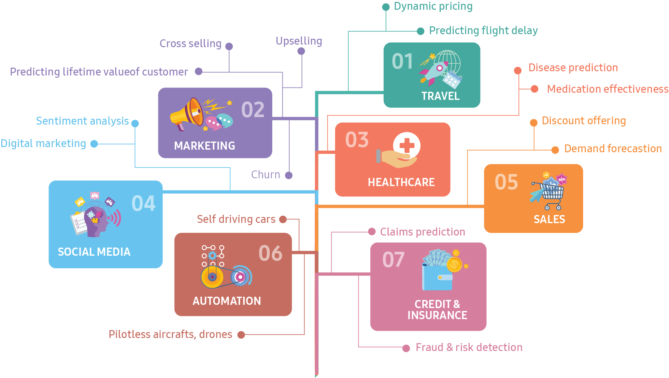
2.1. Applications of Artificial Intelligence
UNIT 02
Applications of Artificial Intelligence

Slide 58
Unit 2.
Applications of Artificial Intelligence
2.1. Applications of Artificial Intelligence
2.2. Image Recognition
2.3. Computer Vision & Machine Vision
2.4. Speech Intelligence

Slide 59
2.2. Image Recognition
UNIT 02
Image Recognition
The benchmark ImageNet classification error rate fell from 26 percent in 2011 to 3.1 percent in 2016, surpassing far beyond the human capability of a 5% error rate.
It was not until the adoption of Convolutional Neural Networks that the image recognition’s accuracy was dramatically improved.
Winning algorithm’s classification error rate
28%
26%
16%
12%
7%
5%
3.6%
3%
2%
NEC-UIUC
XRCE
AlexNet
ZFNet
1. GoogLeNet
2. VGGNet
ResNet
GoogLeNet-v4
SENet
Feature Engineering
Convolutional Neural Networks
ImageNet
Notes:
Image recognition accuracy of artificial intelligence has already surpass far beyond the human level.
Adoption of Convolutional Neural Networks significantly improved accuracy of image recognition.
[Reference Source]
Review: SENet — Squeeze-and-Excitation Network, Winner of ILSVRC 2017 (Image Classification)
https://towardsdatascience.com/review-senet-squeeze-and-excitation-network-winner-of-ilsvrc-2017-image-classification-a887b98b2883

Slide 60

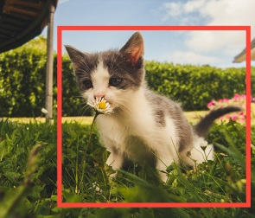
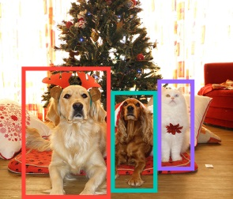

2.2. Image Recognition
UNIT 02
Image recognition refers to technologies that identify places, logos, people, objects, buildings, and other variables in images.
Besides image recognition, computer vision also includes event detection, object recognition, learning, image reconstruction, and video tracking.
Semantic Segmentation
Classification + Localization
Object Detection
Instance Segmentation
GRASS, CAT,
TREE, SKY
CAT
DOG, DOG, CAT
DOG, DOG, CAT
No Objects, just pixels
Single Object
Multiple Object
https://mlwhiz.com/blog/2018/09/22/object_detection/
Notes:
Application of Image Recognition
Automotive Industry: Image recognition and processing is an essential part of autonomous vehicles. Cars of the future are expected to detect obstacles and warn you about proximity to guardrails and walkways. The technology is even capable of reading road signs and stop lights. Computer vision systems powered by deep learning are trained using thousands of images. Images of road signs, humans, roads, etc. under different weather conditions are fed into the neural networks. The systems get intelligent as more training data is fed into the system.
E-commerce Industry: The level of adoption of this technology is the highest in e-commerce including search and advertising. Image recognition can transform your smartphone into a virtual showroom. It is used in mobile applications to identify specific products. It presents a more interactive view of the world by making everything they see searchable.
Gaming Industry: The world of gaming will be revolutionized by image recognition and computer vision technology. In fact, this revolution is already started. The Microsoft Kinect video game holds Guinness World Record for the fastest-selling consumer electronics device ever. The game is based on computer vision and tracks the human body in real time. Serious gamers are more inclined towards the ones with action in the real world away from the device. Image recognition holds the key in generating such new user experiences and user interfaces.
[Reference Source]
Application of Image Recognition https://marutitech.com/working-image-recognition/
Image Recognition market size https://www.marketsandmarkets.com/Market-Reports/image-recognition-market-222404611.html

Slide 61
Unit 2.
Applications of Artificial Intelligence
2.1. Applications of Artificial Intelligence
2.2. Image Recognition
2.3. Computer Vision & Machine Vision
2.4. Speech Intelligence

Slide 62
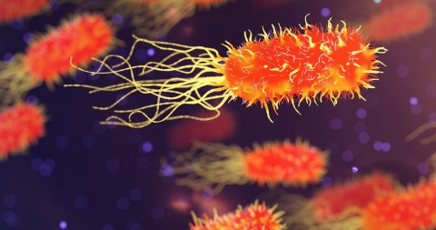
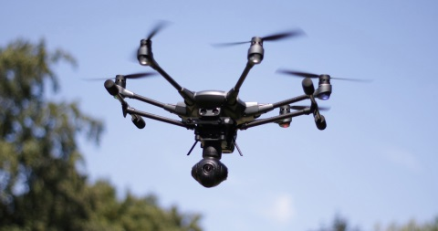
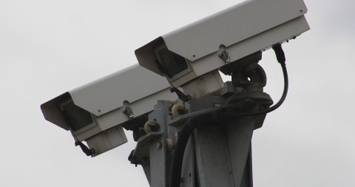
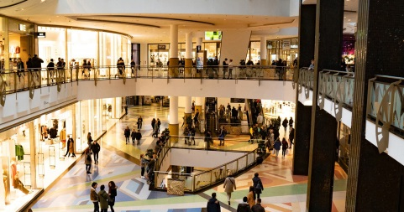
2.3. Computer Vision & Machine Vision
UNIT 02
Computer Vision & Machine Vision
Computer vision is an interdisciplinary scientific field that deals with how computers can be made to gain a high-level understanding of digital images or videos.
Computer vision tasks include acquiring, processing, analyzing, and understanding digital images and extracting high-dimensional data from the real world to produce numerical or symbolic information.
The applications of computer vision are various. They include agriculture, geoscience, biometrics, augmented reality, medical image analysis, robotics, industrial quality inspection, security, and surveillance.
Scientific Research
Natural Resources Management
Protection and Security
Marketing
Wikipedia, Vidolab
Notes:
Application of Computer vision
Scientific Research: Thousands of laboratories worldwide employ computer vision systems as the core of scientific experiments. Chemical and physical labs get access to the processes, which used to be invisible for a human naked eye. Thus, they have a unique opportunity of getting the exhaustive information. With computer vision technologies, biologists can study animal behavior. It can be achieved regardless of the physical location - at the lab or in the wild. Medical specialists can benefit from computer vision as well while conducting tests or working on new medicines.
Protection and Security: The security issue is of critical importance for businesses. Moreover, it is also useful for individuals who care about their personal safety. Computer vision technologies are widely used to protect both offices and homes from intruders. Computer vision systems enable to track objects and detect suspicious activities requiring immediate response. It’s all possible with computer vision software.
Natural Resources Management: Apparently, natural resources are key for the economic development of many countries. A huge number of countries are depending on mining, agriculture, or forestry. In any case, computer vision is a great solution for remote inspection, monitoring, and fast decision making. With accurate geospatial data thanks to computer vision software, many businesses can move to the new level of resource monitoring. Surveillance drone technology is a reliable way to detect natural resources such as oil, gas, and minerals. Additionally, the same technology can be adopted to the crop monitoring
Marketing: Retail businesses rely heavily on computer vision technologies in improving their marketing strategy. In order to increase sales, retail stores examine the flow of their visitors. First, they determine the heaviest traffic hours of their shops. Second, they define dwelling time of their customers in a certain section of the store. Third, they study which products entice their customers and find out those that are in demand. Finally, they identify VIPs in a timely manner and, of course, authenticate known shoplifters to avoid thefts.
[Reference Source]
Computer Vision https://en.wikipedia.org/wiki/Computer_vision
Machine vision (industrial use of computer vision, subset of computer vision) vs computer vision https://appen.com/blog/computer-vision-vs-machine-vision/

Slide 63
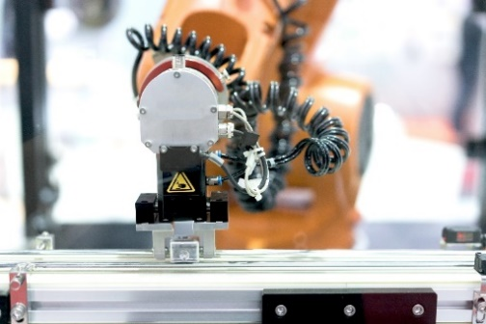
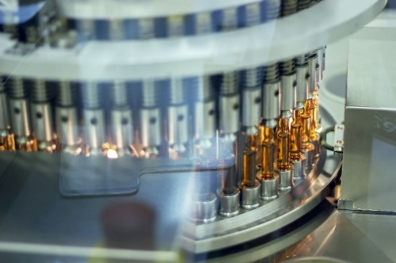
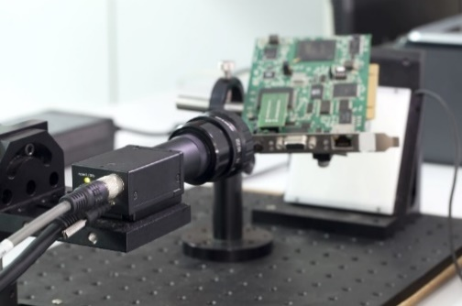
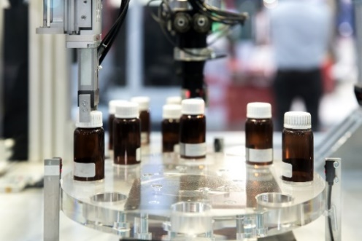
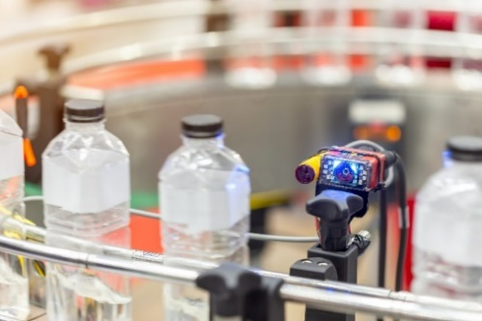
2.3. Computer Vision & Machine Vision
UNIT 02
Computer Vision & Machine Vision
Machine vision as a systems engineering discipline is distinct from computer vision, a form of computer science. It attempts to integrate existing technologies in new ways and apply them to solve real-world problems.
Machine vision refers to many technologies, software and hardware products, integrated systems, actions, methods, and expertise.
Machine vision (MV) is a technology and method often used in industry to provide imaging-based automatic inspection and analysis for such applications as automatic inspection, process control, and robot guidance.
Guidance
Gauging
Defect Detection
Packaging Inspection
Wikipedia, Vidolab, DevisionX
Notes:
Application of Machine Vision
Guidance: A lot of manufacturing processes require high accuracy to within a millimeter. Machine vision software enables businesses to identify and recognize a variety of characteristics of the item. Machine vision systems are able to locate the position and orientation of a part and evaluate its accuracy concerning a specified tolerance, angle, etc. Those information is helpful especially for measuring and verifying assembly. They can also report the location and orientation of a part in 2D or 3D space to the robot locating the part or machine controller aligning the part.
Gauging: A machine vision system can calculate the distances between two or more points or geometrical locations on an object with pixel accuracy. It can perform thousands of measurements per second. Moreover, it does a good job even with such tricky calculations as circularity. A machine vision system defines if the measurements meet expectations. In case they don’t, it sends a signal. As a result, the object is ejected from the line because it has some form of a production error.
Defect Detection: Machine vision systems can check products for defects by automatically detecting and classifying them. Defects can be either cosmetic or affect the product functionality. Whatever the defect is, the system can react with a sound alarm or shut down the production.
Packaging Inspection: Dealing with bottles, machine vision systems can verify the fill level as well as detect open, cocked, and improperly torqued caps. When it comes to the box package, they can also detect damaged or incorrectly packaged ones. In addition, they can check that all edges are straight and parallel and nothing protrudes from the box.
[Reference Source]
Machine vision https://en.wikipedia.org/wiki/Machine_vision#Methods_and_sequence_of_operation
Machine vision (industrial use of computer vision, subset of computer vision) vs computer vision https://appen.com/blog/computer-vision-vs-machine-vision/
Industrial applications of Machine Vision https://devisionx.com/industrial-applications/food-and-beverage/
Machine Vision: Optics in manufacturing https://www.slideshare.net/djehlke/machine-vision

Slide 64
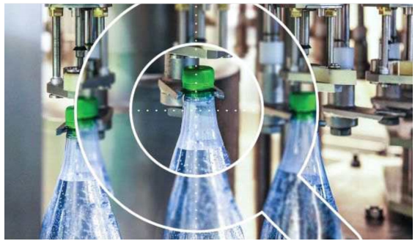
2.3. Computer Vision & Machine Vision
UNIT 02
Acquire Automation – Machine Vision
Acquire Automation has a wide range of automated vision solutions that can ideally pack and verify a company’s product quality at the level required by the government or regulatory body.
For example, the manufactured bottle is inspected at 360 degrees to ensure that the product is packaged correctly and that all components are properly included.
In detail, functions such as whether the cap is closed, seal, position and inclination, label identification, color, and barcode checks are performed.
It also collects and provides data through machine vision technology to provide real-time production statistics and facilitate process control.

Slide 65

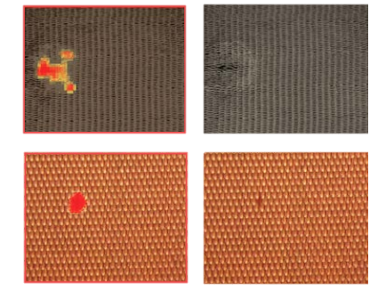
2.3. Computer Vision & Machine Vision
UNIT 02
Cognex – VisionPro ViDi
Cognex is a machine vision systems, software, and sensor manufacturer. It has launched Vision Pro ViDi, a deep learning-based image analysis software optimized for factory automation.
VisionPro ViDi can solve defect detection, texture and material classification, assembly inspection, and text deciphering, which are difficult to program with rule-based algorithms.
Since it is used for the special purpose of analyzing industrial images, only a few hundred images are required, and the training and verification time is short. The computing costs are also low.
It was targeted for non-expert use in the visual field and developed according to actual factory conditions.
PRINTING
WEAVING
Cognex’s brochure

Slide 66

2.3. Computer Vision & Machine Vision
UNIT 02
Focal
Focal is an AI and computer vision-based stock detection systems service.
Small and inexpensive cameras are installed in each store passage, and photos are taken once every 30 minutes.
They detect and recognize out-of-stock products in the image and provide a chart to the employees.
It claims that it takes about four hours daily for human employees to recognize out-of-stock products.
As labor costs increase, the number of unmanned retail stores is growing. Still, the reality is that checking and replenishing inventory has become slower as manpower decreases.
Furthermore, instead of a barcode scan, items can be scanned and calculated with a local camera on the conveyor belt when checking out. Transaction time can be reduced by 60% when employees focus on packaging.
By providing a comparative analysis of the inventory status of sold-out products and competitive products by the hour in the form of a chart, we can obtain insights into the store operation.

Slide 67
Unit 2.
Applications of Artificial Intelligence
2.1. Applications of Artificial Intelligence
2.2. Image Recognition
2.3. Computer Vision & Machine Vision
2.4. Speech Intelligence

Slide 68

2.4. Speech Intelligence
UNIT 02
Natural Language Processing
Natural language processing (NLP) is a subfield of linguistics, computer science, information engineering, and artificial intelligence concerned with the interactions between computers and human (natural) languages, particularly how to program computers to process and analyze large amounts of natural language data.
Challenges in NLP frequently involve speech recognition and natural language understanding and generation.
Machine Translation, Information Retrieval, Question Answering, Information Extraction, and Summarization are the main applications of natural language processing techniques.
Natural language
generation
Text
classification
NLP
Natural language
understanding
Information
retrieval
Wikipedia, Expert System
Notes:
Application of NLP
Machine Translation: The need to access information in online becomes increasingly important and the value of natural language processing applications becomes important. By translating technical manuals, support content or catalogs at a significantly reduced cost, machine translation helps us overcome language barriers that we often encounter. The challenge with machine translation technologies does not lie in translating words, but in understanding the meaning of sentences to provide a effective translation.
Automatic summarization: Information overload is a real problem when we need to access a specific piece of information from a huge knowledge base. Automatic summarization is especially relevant when used to provide an overview of a news item or blog posts, while avoiding redundancy from multiple sources and maximizing the diversity of content obtained.
Sentiment analysis: The goal of sentiment analysis is to identify sentiment among several posts where emotions are not always explicitly expressed. Companies use natural language processing applications, such as sentiment analysis, to identify opinions and sentiment online to help them understand what customers think about their products and services and overall indicators of their reputation.
Text classification: Text classification makes it possible to assign predefined categories to a document and organize it to help you find the information you need or simplify some activities. spam filtering in email, fake news detection, and genre classification are the good examples of text classification.
Question Answering: As speech-understanding technology and voice-input applications improve, the need for NLP will increase. Question-Answering (QA) is becoming more and more popular thanks to applications and virtual assistants such as Bixby. A QA application is a system capable of coherently answering a human request. It may be used as a text-only interface or as a spoken dialog system. It has been significantly improved in terms of its capability to respond as humans.
[Reference Source]
NLP – Current Applications and Future Possibilities https://emerj.com/partner-content/nlp-current-applications-and-future-possibilities/
NLP applications https://expertsystem.com/natural-language-processing-applications/
NLP and Social Media https://medium.com/@paldesk/natural-language-processing-and-social-media-8e7378737d00
NLP applications https://www.upgrad.com/blog/5-applications-of-natural-language-processing-for-businesses/
NLP Applications https://www.cs.upc.edu/~gatius/mai-ihlp/Applications2018.pdf
NLP market size 2016-2025 https://emerj.com/partner-content/nlp-current-applications-and-future-possibilities/

Slide 69
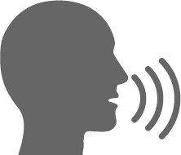
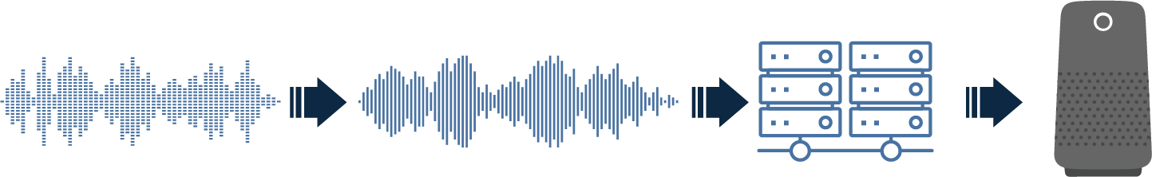
2.4. Speech Intelligence
UNIT 02
Speech & Voice Recognition
Speech Recognition: Recognize words, sentences, and contents spoken by anyone.
General dictation, transcribing, using a computer hands-free, medical transcription, automated customer service, etc.
Voice Recognition: Recognize the accent, pitch, or intonation of a person regardless of the language spoken.
Speaker verification and speaker identification
Voice recognition
ANALOG
AUDIO
ANALOG-TO-DIGITAL
CONVERSION
PATTERN
RECOGNITION
Notes:
Speech recognition vs. voice recognition
The purpose of speech recognition is for a computer or machine to successfully identify the words spoken by anyone. With this, there is no need to pay attention to more personal details such as accent, cadence, and the like.
Speech recognition technology has a long list of applications. Speech recognition software programs are used for general dictation, transcribing, using a computer hands-free, medical transcription, automated customer service, etc.
On the other hand, voice recognition is about being able to identify and understand one specific voice. The most widespread use of this technology is with virtual assistants such as Samsung’s Bixby. In fact, it has been predicted that 75% of US households will own and use at least one smart speaker by 2020.
Speaker verification is using a person’s voice to authenticate that they are who they claim to be. Essentially, a person’s voice is used as a unique identifier. A sample of their speech is recorded. Then, that person’s speech patterns are compared against a database to see if there is a match between the person’s voice and their voice sample.
[Reference Source]
Speech recognition vs. voice recognition https://www.transcribeme.com/speech-vs-voice-recognition-whats-the-difference
Speech recognition vs. voice recognition https://www.totalvoicetech.com/difference-between-voice-recognition-and-speech-recognition/
Applications of voice recognition (speaker recognition) https://searchcustomerexperience.techtarget.com/definition/voice-recognition-speaker-recognition

Slide 70


2.4. Speech Intelligence
UNIT 02
Barbie – Hello Barbie
Barbie, the world-renowned doll manufacturer, has developed an AI toy that can talk.
Hello Barbie analyzes and responds to children’s speech using natural language processing and AI.
When you press the conversation button on the doll, the built-in microphone records what the child says, sends it to the server. The AI selects an appropriate response and sends it back to the doll’s speaker.
Hello Barbie can remember what the children said and respond again later.
The AI can predict conversations of children aged 3 to 9 and exchange conversations with children up to 200 times.
Ex
If you say that Taylor Swift is your favorite singer, the AI will repeat the same answer a few weeks later.
HI! I’M BARBIE!

Slide 71

2.4. Speech Intelligence
UNIT 02
Personetics - Assist
Assist is a domain-specific advisory chatbot service that combines knowledge of consumer finance and financial industries with interactive AI functions.
It is gaining popularity among global banks as it can conveniently provide 24-hour customer service without labor costs.
Assist integrates the latest customer transaction data into the conversation to provide responses based on individual financial activities and banking history.
It also uses predictive analysis to predict customer questions and problems. It provides timely insights and advice one step ahead of the customers.
Assist is built based on natural language processing and can replace tasks such as remittance, reservation, and password change.
It can also distribute customer interaction channels to message platforms like Facebook Messenger and AI assistant platforms like Amazon’s Alexa.

Slide 72
Unit 3.
Techniques in Artificial Intelligence
3.1. Edge AI
3.2. Medical Imaging & Diagnostics
3.3. Autonomous Vehicle
3.4. Reinforcement Learning
3.5. Conversational AI
3.6. GAN, XAI, Synthetic Training Data

Slide 73









3.1. Edge AI
UNIT 03
Definition and Concept
Instead of communicating with a central cloud or server, running AI algorithms on edge devices (ex., smartphones, cars, wearable devices, etc.) provides the ability to process information locally and respond to situations more quickly.
For example, an autonomous vehicle must respond in real time to what’s happening on the road and function in areas without internet connectivity. Decisions are time-sensitive, and latency could prove fatal.
CLOUD COMPUTING
FOG COMPUTING
EDGE COMPUTING
CB Insights
Notes:
Advantages of edge computing
Although a nascent stage, edge computing offers some obvious benefits:
Real-time or faster data processing and analysis: Data is processed closer to the source, not in an external data center or cloud, which reduces lag time.
Lower costs: Enterprises spend less on data management solutions for local devices than for cloud and data center networks.
Less network traffic: With an increasing number of IoT devices, data generation continues to rise at record rates. As a result, network bandwidth becomes more limited, overwhelming the cloud and leading to a greater bottleneck of data.
Increased application efficiency: With lower latency levels, applications can operate more efficiently and at faster speeds.
[Reference Source]
What is edge computing https://www.cbinsights.com/research/what-is-edge-computing/
Advantages of edge computing
https://www.cbinsights.com/research/what-is-edge-computing/

Slide 74


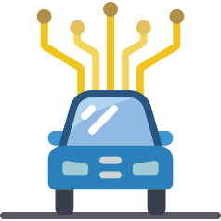







3.1. Edge AI
UNIT 03
Initiatives
In-home smart cameras that recognize persons entering an area
On-device facial recognition and object recognition, where user data does not leave the device
Instantaneous driving decisions
Vision for baby monitors, drones, robots, and other devices that can respond to situations without an internet connection
Edge AI
use case
IQ cameras,
Deep Lens
AI processor
Custom AI chip
Myriad X
CB Insights
Notes:
Nvidia and Qualcomm, along with a number of emerging startups, are focused on building chips exclusively for AI workloads at the “edge.”
From consumer electronics to telecommunications to medical imaging, edge AI has implications for every major industry.
For example, an autonomous vehicle has to respond in real-time to what’s happening on the road, and function in areas with no internet connectivity. Decisions are time-sensitive and latency could prove fatal.
[Reference Source]
What is edge computing https://www.cbinsights.com/research/what-is-edge-computing/

Slide 75
Unit 3.
Techniques in Artificial Intelligence
3.1. Edge AI
3.2. Medical Imaging & Diagnostics
3.3. Autonomous Vehicle
3.4. Reinforcement Learning
3.5. Conversational AI
3.6. GAN, XAI, Synthetic Training Data

Slide 76
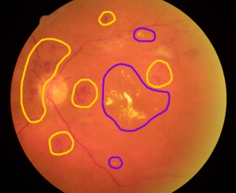
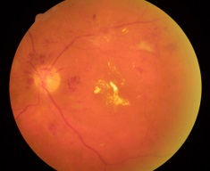
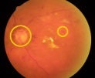
3.2. Medical Imaging & Diagnostics
UNIT 03
AI-as-a-medical-device
Autonomous AI algorithm based on biomarkers
In April 2018, the FDA approved AI-based software that screens patients for diabetic retinopathy without needing a second opinion from a medical specialist.
The software, IDx-DR, correctly identified patients with “more than mild diabetic retinopathy” 87.4% of the time and those who did not have it 89.5% of the time.
IDx is one of the many AI-based software products approved by the FDA for clinical and commercial applications recently.
Biomarker Detection(mostly CNN)
Hemorrhages
Microaneurysms
Exudates
Quality Assessment
IRMAs etc.…
Disease
Assessment
Clinical Decision
Physiologically plausible AI: Abramoff et al, IOVS 2007
Abramoff et al, Nat Dig Med 2018
Anatomy
Localization
CB Insights, IDx

Slide 77



3.2. Medical Imaging & Diagnostics
UNIT 03
AI-as-a-medical-device
Diabetic Retinopathy
Liver and Lung AI Lesion
CT-Scan Analysis for Strokes
FDA clearance
AI-based software that screens patients for diabetic retinopathy without confirmation from medical specialists
FDA clearance
GE Ventures-backed startup
Oncology AI suite initially focused on spotting lung and liver lesions.
FDA clearance
Analyze CT scans and notify healthcare providers of potential strokes in patients
$21M Series A round from Google Ventures and Kleiner Perkins Caufield & Byers
CB Insights
Notes:
The FDA cleared Viz LVO, a product from startup Viz.ai, to analyze CT scans and notify healthcare providers of potential strokes in patients. Post FDA clearance, Viz.ai closed a $21M Series A round from Google Ventures and Kleiner Perkins Caufield & Byers.
The FDA also cleared GE Ventures-backed startup Arterys for its Oncology AI suite initially focused on spotting lung and liver lesions.
Fast-track regulatory approval opens up new commercial pathways for over 80 AI imaging & diagnostics companies that have raised equity financing since 2014, accounting for a total of 149 deals.
[Reference Source]
Arterys Receives First FDA Clearance https://www.prnewswire.com/news-releases/arterys-receives-first-fda-clearance-for-broad-oncology-imaging-suite-with-deep-learning-300599275.html
Viz.ai Product Animation - Viz LVO and Viz CTP https://www.youtube.com/watch?v=y3P9aVwDOig

Slide 78
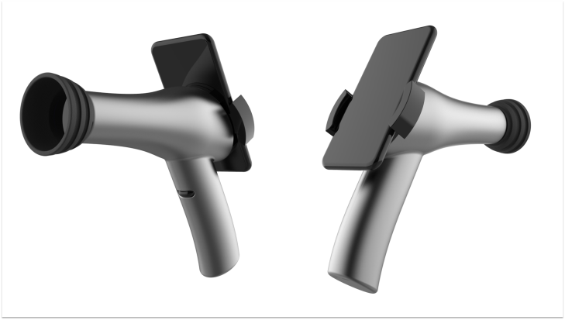
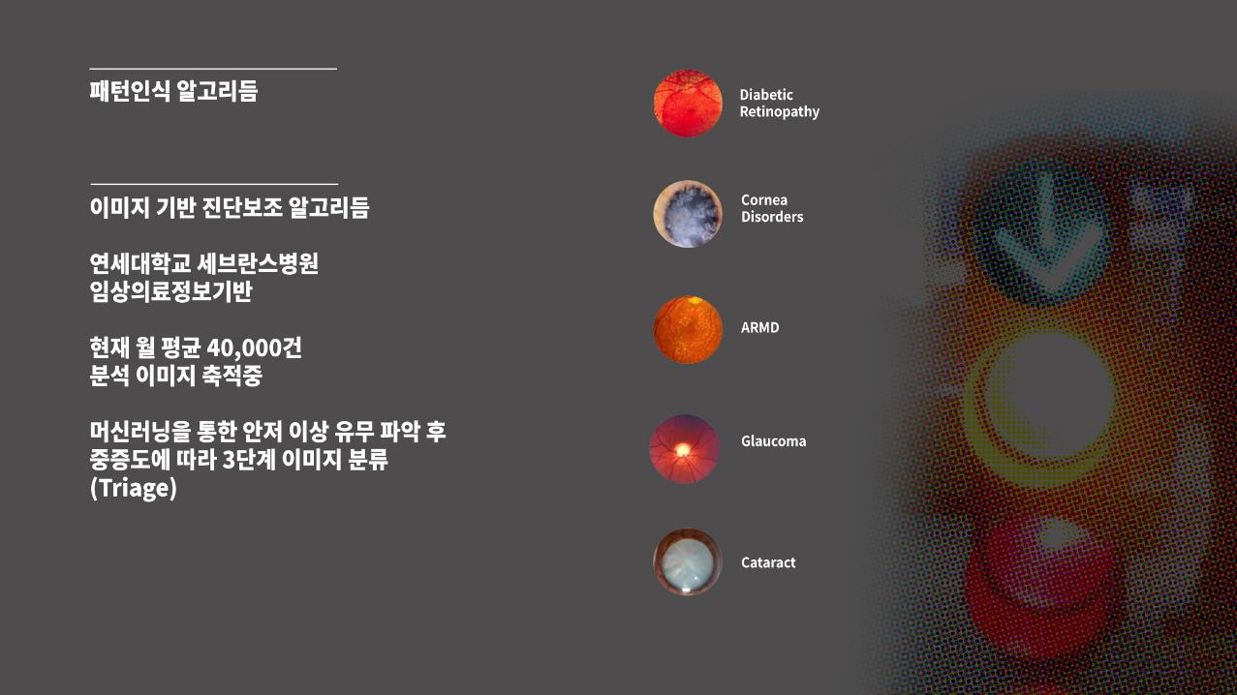
3.2. Medical Imaging & Diagnostics
UNIT 03
Portable Ophthalmoscope Based on AI (Project Powered by Samsung)
Developed a portable diagnostic device and diagnosis support algorithm based on image processing for underserved people in Vietnam.
40,000 images are being accumulated per month.
Detect anomalies from eye images based on Machine learning and classify the image for triage.
Diabetic Retinopathy
Cornea Disorders
ARMD
Glaucoma
Cataract
Samsung, Project BOM
Notes:
Similarly, Samsung launched a corporate social responsibility project which aims to create a portable ophthalmoscope for underserved people in Vietnam by recycling mobile handsets.
“Trash to treasure”
A portable, easy to use, digital ophthalmoscope at an affordable price range utilizing recycled mobile handset
Key components of the portable ophthalmoscope are an inexpensive yet high-quality camera which is a good fit for mass production and telecommunication module to connect medical specialists dispatched over a wide range of area
Without ophthalmologist training, a user can easily photograph fundus with minimum training.
Benefit
Boost ocular diagnostic capability of unskilled healthcare staffs
Create synergy effect with local ocular healthcare project which focus on treatment (Enhance efficiency and effectiveness)
Reduce the number of ophthalmologist’s initial examination and improve working environment
Reduce ocular healthcare cost in comprehensive public healthcare perspective
Provide portable digital ophthalmoscope with a significantly affordable cost (merely 1% of existing devices’ costs)
[Reference Source]
igeeTalks on Galaxy Upcycling Project for Global Health https://www.youtube.com/watch?v=pSHacTstOAU&list=PLZGoT8OiX8oAU2SAvgmhjX98sI8GSKs2w

Slide 79
Unit 3.
Techniques in Artificial Intelligence
3.1. Edge AI
3.2. Medical Imaging & Diagnostics
3.3. Autonomous Vehicle
3.4. Reinforcement Learning
3.5. Conversational AI
3.6. GAN, XAI, Synthetic Training Data

Slide 80






3.3. Autonomous Vehicle
UNIT 03
Autonomous Vehicle
Level of Automation
Automation Levels
ADAS¹⁾
Autonomous
Level 1
Level 2
Level 3
Level 4
Level 5
Driver
Assistance
Everything on
Partial
Automation
Feet Off
Conditional
Automation
Hands Off
High
Automation
Eyes Off
Full
Automation
Mind Off
ACC(Braking)
Lane Keeping
Auto Emergency
Braking
Parallel Park Assist
ACC(Steering)
Lane Changing
Traffic Jam Assist
Overtaking Assist
Highway Driving ~50mph Driver Initiated Lane Change Automated Valet Park Traffic Jam Chauffeur
Highway Driving ~100mph
Automated Lane Change Cruising Chauffeur Free Drive
Robo-taxi Autonomous Shuttle All Driving Conditions
Note: 1) ADAS : Advanced Driver Assistance Systems
IEEE Spectrum, SAE International, Evercore ISI
Notes:
Thanks to technological advancement, especially artificial intelligence technology, autonomous vehicles that is capable of sensing its environment and moving with little or no human input, have been introduced.
A classification system based on six different levels (ranging from fully manual to fully automated systems) was published in 2014 by SAE International, an automotive standardization body, as J3016, Taxonomy and Definitions for Terms Related to On-Road Motor Vehicle Automated Driving Systems
Waymo announced that it has been running Level 4 autonomous cars, with no human behind the wheel, in Arizona since 2017.
[Reference Source]
SAE (J3016) Automation Levels https://en.wikipedia.org/wiki/Self-driving_car
Automation Levels Image https://spectrum.ieee.org/transportation/self-driving/accelerating-autonomous-vehicle-technology
Waymo Says More Of Its Self-Driving Cars Operating ‘Rider Only’ With No One At Wheel https://www.forbes.com/sites/alanohnsman/2019/10/28/waymos-autonomous-car-definition-if-you-need-a-drivers-license-its-not-self-driving/#130675296478
Waymo achieved level 4, while Tesla achieved only level 2 https://www.thedrive.com/tech/15848/waymo-is-already-running-cars-with-no-one-behind-the-wheel
Not Only Cars: The Six Levels of Autonomous Testing
https://medium.com/@giltayar/not-only-cars-the-six-levels-of-autonomous-testing-a22611ab1d7f

Slide 81


3.3. Autonomous Vehicle
UNIT 03
Miles per Disengagement
All companies actively testing self-driving cars on public roads in California are required to disclose the number of miles driven and the frequency in which human drivers were forced to take control of their driverless vehicles - also known as a “disengagement.”
Waymo said its autonomous system only disengaged at a rate of once every 11,017 miles. GM Cruise reported the second-lowest disengagement rate, with a safety driver taking over every 5,205 miles
Other startups making progress include Zoox (0.50 disengagements per 1,000 miles), Nuro (0.97 disengagements per 1,000 miles), and Pony.ai (0.98 disengagements per 1,000 miles).
Waymo Disengagement Rate
Per 1000 Miles
1.26M
.64
636K
Miles Driven in California
424K
352K
.09
.19
.18
The Verge, Forbes
Notes:
The chart explains Waymo’s disengagement rate (0.09 disengagement per 1,000 miles) and miles driven in California (1.26M miles). Disengagement rate has been significantly improved and the miles driven are dramatically increased over four years.
California requires developers who test Level 3 and above automated driving systems in the state to report some basic statistics about vehicle operations each year, including the number of vehicles currently in operation, miles driven and the number of disengagements. These last two figures are combined to calculate miles per disengagement.
Waymo’s autonomous system disengaged, meaning a human safety driver had to take the wheel, at a rate of once every 11,017 miles (50% reduction in the rate and a 96% increase in the average miles traveled between disengagements). And that happened as it boosted testing in the state to 1.2 million miles from 352,000 miles in 2017.
GM Cruise reported the second-lowest disengagement rate, with a safety driver taking over once every 5,205 miles, 321% better than a year ago, according to data released by California’s Department of Motor Vehicles.
The value of the data is limited, however, as the figures don’t factor in the complexity of environments in which vehicles are tested–dense urban settings, versus low-speed suburbs or less complex highway driving–nor do they show conditions including weather, light or speed.
[Reference Source]
California requires miles per disengagement https://hackernoon.com/why-miles-per-disengagement-misses-the-point-as-an-autonomous-vehicle-success-metric-86da67768ec2
Waymo tops disengagement https://www.forbes.com/sites/alanohnsman/2019/02/13/waymo-tops-self-driving-car-disengagement-stats-as-gm-cruise-gains-and-tesla-is-awol/#4540246b31ec
California’s self-driving car reports are imperfect, but they’re better than nothing https://www.theverge.com/2019/2/13/18223356/california-dmv-self-driving-car-disengagement-report-2018
Disengagement report raw data https://thelastdriverlicenseholder.com/2019/02/12/disengagement-reports-2018-preliminary-results/

Slide 82
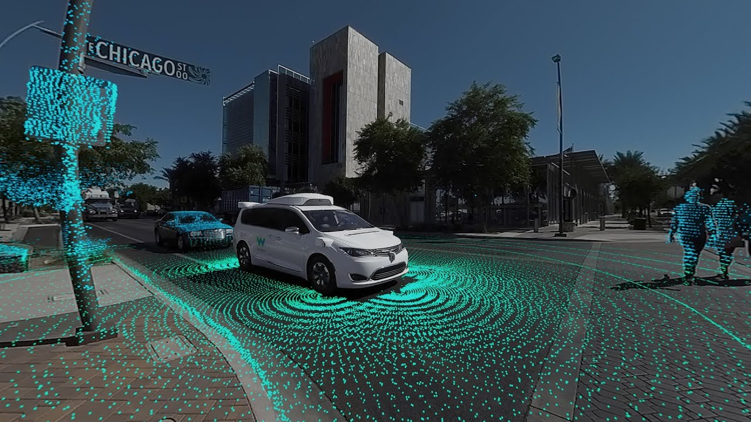
3.3. Autonomous Vehicle
UNIT 03
Miles per Disengagement
Google has made a name for itself in the auto space. Its self-driving project Waymo is the first autonomous vehicle developer to deploy a commercial fleet of AVs.
Investors remain confident in companies developing the full autonomous driving stack, pouring hundreds of millions of dollars into GM’s Cruise Automation ($750M from Honda in October 2018 and $900M from SoftBank in May prior) and Zoox ($500M in July 2018). Other startups here include Drive.ai, Pony.ai, and Nuro.
https://www.forbes.com/sites/alanohnsman/2018/03/02/waymo-is-millions-of-miles-ahead-in-robot-car-tests-does-it-need-a-billion-more/#c854b381ef4c
Notes:
Google is far ahead of its competitors. Waymo opened its on-demand ride service to people in a portion of suburban Phoenix, accessing it via a branded app, Waymo One (December 2018). And several startups are chasing after Waymo
[Reference Source]
Waymo Is Millions Of Miles Ahead In Robot Car Tests; Does It Need A Billion More?
https://www.forbes.com/sites/alanohnsman/2018/03/02/waymo-is-millions-of-miles-ahead-in-robot-car-tests-does-it-need-a-billion-more/#c854b381ef4c
At Waymo, It’s Launch Time For Google’s Biggest Moonshot https://www.forbes.com/sites/alanohnsman/2018/11/30/10-million-miles-later-waymo-ceo-says-its-self-driving-cars-are-ready-for-prime-time/#7f5368ee75e7

Slide 83











3.3. Autonomous Vehicle
UNIT 03
China Market
The Chinese science ministry announced last year that the nation’s first wave of open AI platforms will rely heavily on Baidu for autonomous driving
In April 2017, Baidu announced a one-of-a-kind open platform called Apollo for autonomous driving solutions, roping in partners from across the globe
AUTOMAKERS
CHIP MAKERS
TIER 1 SUPPLIERS
LiDAR TECH
MAPPING SERVICES
OPERATING SYSTEM
TRAVEL SERVICES
CLOUD SERVICES
CB Insights
Notes:
Besides Baidu, Alibaba recently conducted test drives of its autonomous vehicle. But interestingly, just over a year ago, Alibaba was skeptical about the long-term commercial opportunity of autonomous vehicles, mentioning in an earnings call that “nobody has figured out the long-term economic model for this, but people are doing it because there is some very interesting artificial intelligence-related technology” involved in building autonomous vehicles.

Slide 84












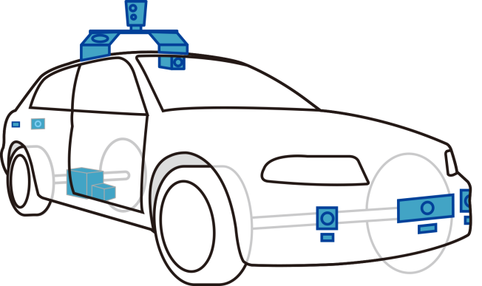






























3.3. Autonomous Vehicle
UNIT 03
Unbundling the Autonomous Vehicle
AUTONOMOUS DRIVING SYSTEMS | COMPUTER VISION | DATA & SIMULATION
Drive.ai Momenta Pony.ai | DeepScale Prophesee | Cognata NVIDIA
FULL SYSTEMS
PERCEPTION
AUTONOMOUS DRIVING
SYSTEM
LIGHT DETECTION & RANGING(LIDAR)
CAMERAS & COMPUTER VISION
FULL VEHICLES
RADAR
LOCALIZATON
PRE-BUILT MAPS
V2X SYSTEMS
DATA & SIMULATION
Insights
Notes:
Highlighted in the slide is the section where artificial intelligence technologies are heavily involved.
[Reference Source]
Technologies and relevant players in the AV market https://www.cbinsights.com/research/startups-drive-auto-industry-disruption/

Slide 85
Unit 3.
Techniques in Artificial Intelligence
3.1. Edge AI
3.2. Medical Imaging & Diagnostics
3.3. Autonomous Vehicle
3.4. Reinforcement Learning
3.5. Conversational AI
3.6. GAN, XAI, Synthetic Training Data

Slide 86
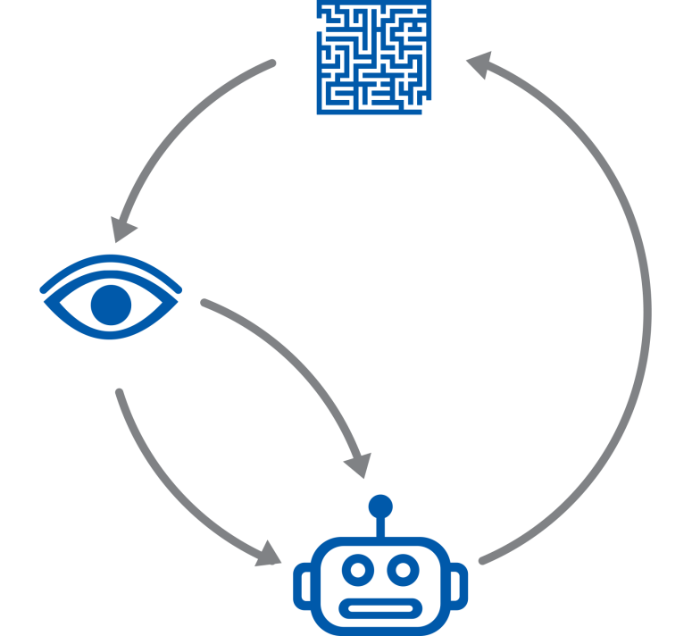
3.4. Reinforcement Learning
UNIT 03
Reinforcement Learning
Definition and Application
DTRs diagnosis
EHR/EMR
Proficiency est. recommendation
education games
Adaptive traffic signal
control
Adaptive decision
control
Healthcare
Education
Transportation
Energy
Environment
Pricing, trading portfolio opt. risk management
Recommendation e-commerce, OR customer mgmt.
Finance
Business
Management
Action
Deep Reinforcement Learning
Interpreter
Reward
Science engineering art
Computer systems
Topics in computer science
Maths, physics chemistry, music drawing, animation
State
Games
Robotics
Computer vision
NLP
Go, poker Dota, bridge Starcraft
Sim-to-real
co-robot
control
Recognition
Detection
perception
Seq. gen.
Translation
Dialog, QA, IE, IR
Agent
Yuxi Li, Deep Reinforcement Learning, arXiv, 2018
Notes:
Reinforcement learning (RL) is a branch of machine learning concerned with the process of learning by trying things, receiving a positive or negative reward (feedback), and then modifying behavior to try and maximize cumulative expected reward.
The typical framing of a RL scenario: an agent takes actions in an environment, which is interpreted into a reward and a representation of the state, which are fed back into the agent.
Application of RL: RL applied to artificial intelligence has found remarkable success in recent years due to breakthroughs in both computing resources and algorithm improvements. Graphics Processing Unit capabilities have been improving tenfold every few years. The improvement, combined with the availability of large datasets, has led to massive breakthroughs in the field of deep learning. Fundamental to deep learning is the concept of a neural network: a collection of nodes (neurons) performing operations on an input and returning an output. A deep neural network has many neurons in sequence. Using deep neural networks to approximate the value (output) of taking an action in some state (input) has led to incredibly advanced reinforcement learning agents in multiple domains. Additionally, algorithmic breakthroughs such as experience replay, self-play, and Monte Carlo tree search have pushed improvements specific to RL. The combination of these advancements has created superhuman players of Atari, Go, and Shogi, and a nearly professional DoTA 2 team of bots.
[Reference Source]
Reinforcement learning https://en.wikipedia.org/wiki/Reinforcement_learning
Reinforcement Learning Applications https://medium.com/@yuxili/rl-applications-73ef685c07eb
Reinforcement Learning Applications: A Brief Guide on How to Get Business Value from RL https://perfectial.com/blog/reinforcement-learning-applications/
SHIELD AI FUNDAMENTALS: ON REINFORCEMENT LEARNING https://www.shield.ai/content/2018/11/20/shield-ai-fundamentals-on-reinforcement-learning
Applications of Reinforcement Learning in Real World https://towardsdatascience.com/applications-of-reinforcement-learning-in-real-world-1a94955bcd12
Reinforcement Learning and Its Practical Applications https://chatbotsmagazine.com/reinforcement-learning-and-its-practical-applications-8499e60cf751

Slide 87
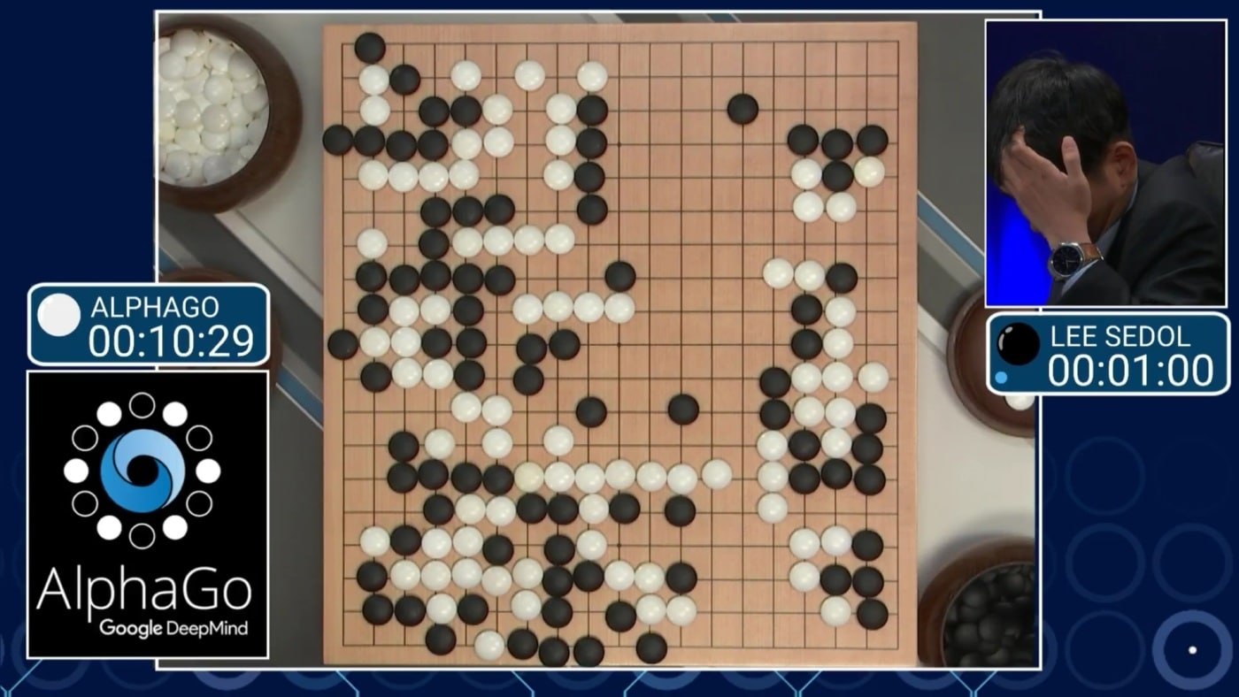
3.4. Reinforcement Learning
UNIT 03
Definition and Application
https://dimensionless.in/reinforcement-learning-super-mario-alphago/
Notes:
AlphaGo played South Korean professional Go player Lee Sedol, ranked 9-dan, one of the best players at Go, with five games. Out of five games, AlphaGo won four games and Lee won the fourth game which made him recorded as the only human player who beat AlphaGo in all of its 74 official games.
AlphaGo was initially trained to mimic human play by attempting to match the moves of expert players from recorded historical games, using a database of around 30 million moves. Once it had reached a certain degree of proficiency, it was trained further by being set to play large numbers of games against other instances of itself, using reinforcement learning to improve its play.
AlphaGo doesn’t know the best strategy, but it knows whether it won or lost. AlphaGo uses a tree search to check every possible move it can make and see which is better. On a 19×19 Go board, there are 361 possible moves. For each of these 361 moves, there are 359 possible second moves and so on. In all, there are about 4.67×10^385 possible moves. Even with its advanced hardware, AlphaGo cannot try every single move. So, it uses another kind of tree search called the Monte Carlo Tree Search. In this search, only those moves that are most promising are tried out. Each time AlphaGo finishes a game, it updates the record of how many games each move won. After multiple iterations, AlphaGo has a rough idea of which moves maximizes its chance of winning.
AlphaGo's victory in Mar 2016 was a great milestone in artificial intelligence history. Go had previously been regarded as a hard problem in machine learning that was expected to be out of reach for the technology of the time. Most experts thought a Go program as powerful as AlphaGo was at least five years away; some experts thought that it would take at least another decade before computers would beat Go champions. Most observers at the beginning of the 2016 matches expected Lee to beat AlphaGo.
[Reference Source]
Reinforcement learning https://en.wikipedia.org/wiki/Reinforcement_learning
Reinforcement Learning Applications https://medium.com/@yuxili/rl-applications-73ef685c07eb
Reinforcement Learning Applications: A Brief Guide on How to Get Business Value from RL https://perfectial.com/blog/reinforcement-learning-applications/
SHIELD AI FUNDAMENTALS: ON REINFORCEMENT LEARNING https://www.shield.ai/content/2018/11/20/shield-ai-fundamentals-on-reinforcement-learning
Applications of Reinforcement Learning in Real World https://towardsdatascience.com/applications-of-reinforcement-learning-in-real-world-1a94955bcd12
Reinforcement Learning and Its Practical Applications https://chatbotsmagazine.com/reinforcement-learning-and-its-practical-applications-8499e60cf751

Slide 88
Unit 3.
Techniques in Artificial Intelligence
3.1. Edge AI
3.2. Medical Imaging & Diagnostics
3.3. Autonomous Vehicle
3.4. Reinforcement Learning
3.5. Conversational AI
3.6. GAN, XAI, Synthetic Training Data

Slide 89


3.5. Conversational AI
UNIT 03
Conversational AI
Voice Assistant
Automated Speech Recognition
Hi, Bixby. Schedule a meeting at 10 a.m. tomorrow!
Sure, I scheduled a meeting in your calendar.
LISTENING
Dialog Management
Natural Language Generation
FORMING RESPONSE
OFFERING RESPONSE
Natural Language Understand
COMPREHENDING
Machine Learning & Deep Neural Networks
CB Insights, Interactions
Notes:
Conversational AI is the set of technologies underlying automated messaging and speech-enabled applications that offer human-like interactions between computers and humans.
Conversational AI can communicate like a human by recognizing speech and text, understanding intent, decoding different languages, and responding in a way that mimics human conversation.
Applied Conversational AI requires both science and art to create successful applications that incorporate context, personalization and relevance within human to computer interaction. Conversational design, a discipline dedicated to designing flows that sound natural, is a key part of developing Conversational AI applications.
Though chatbots have gained popularity, conversational AI can be offered over both text and voice form and thus various channels and devices that offer support these forms – from web chat for text form to phone call and smart speakers for voice form.
The best Conversational AI offers an end result that is indistinguishable from could have been delivered by a human.
Algorithm
Conversational AI generally uses various technologies such as Automatic Speech Recognition (ASR), Natural Language Processing (NLP), Advanced Dialog management, and Machine Learning (ML) to understand, react and learn from every interaction.
Difference between Conversational AI and Chatbot
Conversational AI applications can be programmed with varying levels of complexity resulting in dramatically different end products.
The simplest example of a Conversational AI application is a FAQ bot. These are basic answer and response machines, also known as Chatbots, where you must type the exact keyword required to receive the appropriate response. In fact, these chatbots are so basic that they may not even be considered Conversational AI at all, as they do not use NLP or dialog management or machine learning to improve over time.
The next maturity level of Conversational AI applications is Virtual Personal Assistants. Examples of these are Amazon Alexa, Samsung’s Bixby, and Google Home. They serve a general purpose and are linear, and do not carry context from one conversation to the next. These assistants use ASR and NLP, but have simple dialog management.
Next we have Virtual “Customer” Assistants, which are more advanced Conversational AI systems that serve a specific purpose and therefore are more specialized in dialog management. These applications are able to carry context from one interaction to the next which enhances the user experience.
On the same level of maturity as Virtual Customer Assistants, are Virtual Employee Assistants. These applications are purpose-built, specialized, and automate processes, also called Robotic Process Automation. They are used in businesses to streamline enterprise operations. Both Virtual Customer Assistants and Virtual Employee Assistants often use the most advanced Conversational AI technologies, and are well integrated into the companies back office systems to provide contextual and personal experience to customers and employees.
[Reference Source]
CONVERSATIONAL AI https://www.interactions.com/conversational-ai/

Slide 90



3.5. Conversational AI
UNIT 03
Duplex
Duplex can make phone calls and reservations on behalf of the user, communicating like a real human. Google added Duplex to its new phone, Pixel 3. It has turned the Pixel 3 into an AI powerhouse, including a “screen call” option that allows the Google Assistant to screen for spam callers.
“Get me an appointment at…”
User
Duplex
business
“You’re all set!”
“How long is the wait usually to be seated?”
“Fifteen to twenty minutes usually”
CB Insights, Google
Notes:
Duplex can make phone calls and reservations on behalf of the user, communicating like a real human (complete with “umms” and pauses). It sparked ethical concerns over whether or not Duplex needs to identify itself as a conversational agent when speaking to real people.
Google added Duplex to its new phone, Pixel 3. It has turned the Pixel 3 into an AI powerhouse, including a “screen call” option that allows the Google Assistant to screen for spam callers.
Google has been applying to patent the interactions between two conversational agents since 2014. The most recent application, “Conversational Agent Response Determined Using A Sentiment,” was filed in April 2018.
[Reference Source]
Google Duplex https://ai.googleblog.com/2018/05/duplex-ai-system-for-natural-conversation.html
Google Duplex can now buy movie tickets for you in Chrome https://www.androidauthority.com/duplex-web-release-1036145/
Google Duplex learns the Internet https://www.youtube.com/watch?v=JbkoQGMf5DI
Google IO 2018 : Google Duplex in Action https://www.youtube.com/watch?v=I2fRxfZTJ2c
“Conversational Agent Response Determined Using A Sentiment” https://pdfaiw.uspto.gov/.aiw?PageNum=0&docid=20180247649&IDKey=05BD3D65A04E&HomeUrl=http%3A%2F%2Fappft.uspto.gov%2Fnetacgi%2Fnph-Parser%3FSect1%3DPTO1%2526Sect2%3DHITOFF%2526d%3DPG01%2526p%3D1%2526u%3D%2Fnetahtml%2FPTO%2Fsrchnum.html%2526r%3D1%2526f%3DG%2526l%3D50%2526s1%3D20180247649%2526OS%3D%2526RS%3D

Slide 91
Unit 3.
Techniques in Artificial Intelligence
3.1. Edge AI
3.2. Medical Imaging & Diagnostics
3.3. Autonomous Vehicle
3.4. Reinforcement Learning
3.5. Conversational AI
3.6. GAN, XAI, Synthetic Training Data

Slide 92

3.6. GAN, XAI, Synthetic Training Data
UNIT 03
Generative Adversarial Network (GAN)
Deep fake
Pictures on this page are all generated by artificial intelligence.
Generative Adversarial Network, also known as GAN, brought groundbreaking innovations in artificial intelligence, especially in generating fake images and videos.
In 2018, researchers at Carnegie Mellon University created a video in which two people showed exactly the same facial expression simultaneously – it is called deep fake.
With the recycled-GAN algorithm, the quality of the fake video was significantly enhanced.
Notes:
Researchers at Carnegie Mellon University have devised a way to automatically transform the content of one video into the style of another, making it possible to transfer the facial expressions of comedian John Oliver to those of a cartoon character, or to make a daffodil bloom in much the same way as a hibiscus would.
Because the data-driven method does not require human intervention, it can rapidly transform large amounts of video, making it a boon to movie production, as well as to the conversion of black-and-white films to color and to the creation of content for virtual reality experiences.
It also has the potential to be used for so-called "deep fakes," videos in which a person's image is inserted without permission, making it appear that the person has done or said things that are out of character. The researchers showed that Recycle-GAN can be used to transform video of Oliver into what appears to be fellow comedian Stephen Colbert and back into Oliver. Or video of John Oliver's face can be transformed into Stephen Colbert or a cartoon character. Recycle-GAN not only enables facial expressions to be copied, but also the movements and cadence of the performance.
Such effects might be useful in developing self-driving cars that can navigate at night or in bad weather. With recycle-GAN, users can transform an easily obtained and labeled daytime scenes into nighttime or stormy scenes, providing images that can be used to train cars to operate in those conditions.
[Reference Source]
Beyond Deep Fakes: Transforming Video Content Into Another Video's Style, Automatically https://www.cmu.edu/news/stories/archives/2018/september/deep-fakes-video-content.html
Transferring One Video Into the Style of Another, Carnegie Mellon University https://www.youtube.com/watch?time_continue=1&v=ehD3C60i6lw&feature=emb_logo
Researchers Come Out With Yet Another Unnerving, New Deepfake Method
https://gizmodo.com/researchers-come-out-with-yet-another-unnerving-new-de-1828977488
Recycle-GAN: Unsupervised Video Retargeting
https://www.cs.cmu.edu/~aayushb/Recycle-GAN/

Slide 93

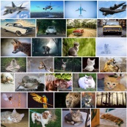
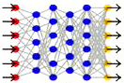





3.6. GAN, XAI, Synthetic Training Data
UNIT 03
XAI (eXplainable AI)
What are we trying to do?
Today
• Why did you do that?
• Why not something else?
• When do you succeed?
• When do you fail?
• When can I trust you?
• How do I correct an error?
Learning
Process
This is a cat
Input
units
Hidden
units
Output
units
Training Data
Learned Function
Output
User with a Task
Tomorrow
• I understand why
• I understand why not
• I know when you'll succeed
• I know when you‘ll fail
• I know when to trust you
• I know why you errored
New
Learning
Process
This is a cat
• It has fur, whiskers,
and claws.
• It has this feature:
Training Data
Explainable Model
Explanation Interface
User with a Task
DARPA
Notes:
Deep learning algorithm is basically a black box, which prevents users to debug when it is not working well. Additionally, there is no way to figure out why and how the results have been generated. In order to solve this problem, DARPA, Defense Advanced Research Projects Agency in the US, launched a project to develop an “eXplainable artificial intelligence”, which is called an XAI.
The Explainable AI (XAI) program aims to create a suite of machine learning techniques that:
Produce more explainable models, while maintaining a high level of learning performance (prediction accuracy)
Enable human users to understand, appropriately trust, and effectively manage the emerging generation of artificially intelligent partners.
New machine-learning systems will have the ability to explain their rationale, characterize their strengths and weaknesses, and convey an understanding of how they will behave in the future. The strategy for achieving that goal is to develop new or modified machine-learning techniques that will produce more explainable models. These models will be combined with state-of-the-art human-computer interface techniques capable of translating models into understandable and useful explanation dialogues for the end user
As a result, human can understand and confidently use the output of algorithm.
[Reference Source]
Explainable Artificial Intelligence (XAI) https://www.darpa.mil/program/explainable-artificial-intelligence

Slide 94


3.6. GAN, XAI, Synthetic Training Data
UNIT 03
Synthetic Training Data
Synthetic Brain Tumor MRI images
Researchers generated synthetic medical images of brain tumors by training a generative adversarial network algorithm with publicly available MRI data
With synthetically generated data,
they were able to improve the accuracy of tumor segmentation.
they used the generative model as an anonymization tool which mitigates the risk of using patients’ medical data without permission.
Original Brain Tumor Image
Synthetic Brain Tumor Image for training tumor segmentation algorithm
DARPA
Notes:
For the first time, researchers are now using GANs to generate abnormal brain MRIs that can be used to train neural networks. To solve this problem a team of researchers from NVIDIA, the Mayo Clinic, and the MGH & BWH Center for Clinical Data Science developed a deep learning-based model that can generate accurate and reliable synthetic images that can be used for training an artificial intelligence system.
With the cuDNN-accelerated PyTorch deep learning framework, the team trained their generative adversarial network on data from two publicly available datasets of brain MRIs. One dataset contains thousands of 3D T1-weighted brain MRIs with Alzheimer’s disease, the other contains about two hundred 4D brain MRIs with brain tumors.
GANs have been used in medical imaging before to generate a motion model from a single preoperative MRI, upsample a low-resolution image, create a synthetic head CT from a brain MRI, perform medical segmentation, and automatically align different types of MRIs, saving doctors hours.
Because the images are synthetically generated, there is no patient data or privacy concerns. Medical institutions can easily share data they generate with other institutions, creating millions of different combinations that can be used to accelerate the work.
[Reference Source]
Deepfakes for good: Why researchers are using AI to fake health data https://www.fastcompany.com/90240746/deepfakes-for-good-why-researchers-are-using-ai-for-synthetic-health-data?partner=rss&utm_source=rss&utm_medium=feed&utm_campaign=rss+fastcompany&utm_content=rss
AI-generated synthetic brain MRI provides diverse, reliable training data
https://www.healthimaging.com/topics/artificial-intelligence/ai-synthetic-brain-mris-diverse-reliable-data
AI Can Generate Synthetic MRIs to Advance Medical Research
https://news.developer.nvidia.com/ai-can-generate-synthetic-mris-to-advance-medical-research/
Medical Image Synthesis for Data Augmentation and Anonymization Using Generative Adversarial Networks
https://www.semanticscholar.org/paper/Medical-Image-Synthesis-for-Data-Augmentation-and-Shin-Tenenholtz/37a052144b510b8827634c38146b190d8b2c8d0b

Slide 95
Unit 4.
Artificial Intelligence: Trends and Markets
4.1. AI Trends
4.2. AI Markets
4.3. AI in Sustainable Energy
4.4. AI in Financial Services
4.5. AI in Government
4.6. AI in Healthcare
4.7. IoT and AI in Agriculture

Slide 96
4.1. AI Trends
UNIT 04
Trend Matrix
High
TRANSITORY
NECESSARY
Open source framework
Facial
recognition
Conversational
agents
Predictive
maintenance
Edge
computing
Application: Computer vision
Cyber threat
hunting
Medical
imaging &
diagnostics
Application: Natural language
processing / synthesis
Synthetic
training data
E-commerce
search
INDUSTRY ADOPTION
Application: Predictive intelligence
Drug discovery
Back office
automation
Language
translation
Crop
monitoring
Architecture
Anti-counterfeit
Check-out free
retail
Autonomous
navigation
Infrastructure
Advanced healthcare
biometrics
Reinforcement
learning
Clinical trial
enrollment
Auto claims
processing
GANs
Network
optimization
Next-gen
prosthetics
Explainable AI
Federated
learning
Low
Capsule Networks
EXPERIMENTAL
THREATENING
Low
MARKET STRENGTH
High
Artificial Intelligence Trends 2019, CB Insights
Notes:
This trend matrix shows which technology is a must-have and which technology promising yet not widely adopted
INDUSTRY ADOPTION (y-axis): Signals include momentum of startups in the space, media attention, customer adoption (partnerships, customer, licensing deals).
MARKET STRENGTH (x-axis): Signals include market sizing forecasts, quality and number of investors and capital, investments in R&D, earnings transcript commentary, competitive intensity, incumbent deal making (M&A, strategic investments).
By those two axis, AI trends are positioned on the four quadrants.
NECESSARY: Trends which are seeing wide-spread industry and customer implementation / adoption and where market and applications are understood. For these trends, incumbents should have a clear, articulated strategy and initiatives.
TRANSITORY: Trends seeing adoption but where there is uncertainty about market opportunity. As Transitory trends become more broadly understood, they may reveal additional opportunities and markets.
THREATENING: Large addressable market forecasts and notable investment activity. The trend has been embraced by early adopters and may be on the precipice of gaining widespread industry or customer adoption.
EXPERIMENTAL: Conceptual or early-stage trends with few functional products and which have not seen widespread adoption. Experimental trends are already spurring early media interest and proof-of-concepts.

Slide 97
Unit 4.
Artificial Intelligence: Trends and Markets
4.1. AI Trends
4.2. AI Markets
4.3. AI in Sustainable Energy
4.4. AI in Financial Services
4.5. AI in Government
4.6. AI in Healthcare
4.7. IoT and AI in Agriculture

Slide 98
4.2. AI Markets
UNIT 04
AI Value Creation by 2030
Innovation created by artificial intelligence (AI) started in the software industry and will soon revolutionize all other industries. The value created by artificial intelligence will reach 13 trillion dollars by 2030.
$13 Trillion
Retail
$0.8T
Travel
$480B
Transport & Logistics
$475B
Automotive & Assembly
$405B
Basic Materials
$300B
Advanced Electronics/Semiconductors
$291B
Healthcare Systems and Service
$267B
High Tech
$267B
Telecom
$174B
Oil & Gas
$173B
Agriculture
$164B
McKinsey Global Institute
Notes:
[Reference Source]
Visualizing the uses and potential impact of AI and other analytics https://www.mckinsey.com/featured-insights/artificial-intelligence/visualizing-the-uses-and-potential-impact-of-ai-and-other-analytics

Slide 99
Unit 4.
Artificial Intelligence: Trends and Markets
4.1. AI Trends
4.2. AI Markets
4.3. AI in Sustainable Energy
4.4. AI in Financial Services
4.5. AI in Government
4.6. AI in Healthcare
4.7. IoT and AI in Agriculture

Slide 100


4.3. AI in Sustainable Energy
UNIT 04
AI in Sustainable Energy
Green AI establishes a connection between computing power and carbon emissions, allowing one to manage the carbon cost of huge AI computing demands to some extent.
Today, greenhouse emissions from the information and communication technology (ICT) industry account for 2% of total emissions (as much as all air traffic). Failure to confirm this will increase up to 14% of global emissions. AI itself can be used for eco-friendly projects.
Examples
Space Intelligence, a British startup, applies machine learning and AI to satellite data to solve environmental problems such as re-seasoning, allowing the industry to take corrective action.
Google has promised not to use carbon by 2030. At the recent Google I/O 2021 event, the company explained these efforts in detail by announcing plans to use geothermal energy to power data centers in Nevada.
Kate Brandt, Google’s head of sustainability, said, “We are the first company to sign a contract for next-generation geothermal power.”

Slide 101

4.3. AI in Sustainable Energy
UNIT 04
AI in Sustainable Energy
https://www.aitrends.com/category/energy/

Slide 102
Unit 4.
Artificial Intelligence: Trends and Markets
4.1. AI Trends
4.2. AI Markets
4.3. AI in Sustainable Energy
4.4. AI in Financial Services
4.5. AI in Government
4.6. AI in Healthcare
4.7. IoT and AI in Agriculture

Slide 103
4.4. AI in Financial Services
UNIT 04
AI in Financial Services
Cyber-attacks and identity fraud losses increased sharply in 2020. The pandemic set the stage for combining AI and biometric recognition to make telecommuting a standard and achieve a higher level of protection.
Banks worldwide saw a 238% surge in cyber attacks between February and April 2020.
According to a Javelin Strategy & Research study, ID fraud losses rose to $56 billion last year. Fraudsters created synthetic IDs using stolen personal information, as accounted by Pymnts.com.
In addition, the number of automated bot attacks increased by 100 million between July and December for companies in various industries.
Companies that strive for better protection risk making their customers’ lives more difficult. It has been reported about 40% of financial institutions often mistake legitimate customers’ online behavior for fraudulent behavior.
Security Benefits of AI and Biometric Recognition
AI can prevent digital identity fraud by providing higher accuracy and speed when verifying an individual’s identity. Or it can integrate biometric data so that cybercriminals cannot access information simply by providing credentials.

Slide 104

4.4. AI in Financial Services
UNIT 04
Pandemic-changed Consumer Financial Behavior, Causes Identity Fraud
The global pandemic has had a dramatic impact on consumer financial behavior. In 2020, consumers spent more time at home, there was less trading than the previous year, and they relied heavily on streaming services, digital commerce, and digital payments.
They also communicated more via email and text about work and personal life.
https://www.aitrends.com/category/financial-services/

Slide 105
Unit 4.
Artificial Intelligence: Trends and Markets
4.1. AI Trends
4.2. AI Markets
4.3. AI in Sustainable Energy
4.4. AI in Financial Services
4.5. AI in Government
4.6. AI in Healthcare
4.7. IoT and AI in Agriculture

Slide 106


4.5. AI in Government
UNIT 04
AI in Government
Wisconsin Department of Workforce Development (DWD) summarized the 2020 backlogs for thousands of unemployment insurance claims with the help of AI cloud computing tools that surged during the pandemic.
DWD handles an average of 157,000 claims per week and has paid a total of $2 billion in unemployment benefits since the pandemic outbreak. According to GCN’s recent account, the agency can now release funds within three business days.
The process took weeks or months, according to Brent Mitchell, the head of state and local governments in Google’s public sector. Recovery was helpful by DWD hiring, contracting, or rearranging 1,300 people to help with backlogs.
DWD used Google Cloud’s DocAI service along with AI and machine learning products. DocAI is used to add value by suggesting ways to automate the extraction of sensitive data from documents and simplify workflows. The Human-in-the-Loop AI function increases accuracy by adding human review.
“With design thinking, close partnerships with state officials, and combination of modern technologies, DWD’s solutions are customized to maximize benefits to components,” said Mitchell.

Slide 107

4.5. AI in Government
UNIT 04
AI in Government
https://www.aitrends.com/category/ai-in-government/

Slide 108
Unit 4.
Artificial Intelligence: Trends and Markets
4.1. AI Trends
4.2. AI Markets
4.3. AI in Sustainable Energy
4.4. AI in Financial Services
4.5. AI in Government
4.6. AI in Healthcare
4.7. IoT and AI in Agriculture

Slide 109
4.6. AI in Healthcare
UNIT 04
AI in Healthcare
In February, the U.S. Food and Drug Administration (FDA) announced a plan regarding the direction for manufacturers that seek FDA approval for innovative medical devices using AI. As a part of this medical device execution plan, the FDA announced AI and machine learning software.
“Artificial Intelligence (AI) and machine learning (ML) technologies have the potential to transform healthcare by drawing new and important insights from vast amounts of data generated during daily healthcare service,” said the author of the report.
This report is a follow-up to the FDA’s 2019 efforts to begin discussions on how to proceed with medical devices using AI in response to a request to update the approval process. “The FDA’s traditional paradigm for regulating medical devices is not designed for adaptive artificial intelligence and machine learning technologies,” said the author of the FDA report.
The FDA’s action plans look for manufacturers’ commitments to maintain device performance with processes for periodic updates as these devices develop. This way, the FDA and manufacturers can evaluate software products from pre-marketing development to post-marketing performance.
This allows the FDA to accommodate the power of AI and ML-based software on medical devices while ensuring patient safety.

Slide 110
4.6. AI in Healthcare
UNIT 04
AI in Healthcare
The author identified promising target uses of AI SaMD in the field of medical devices, including the following:
Heart Disease Diagnosis: A machine learning algorithm was used to train AI platforms using data from 3,013 patients. It integrated age and gender paired with high-sensitivity heart troponin I concentration (myocardial ischemic injury index).
The platform was then tested on 7,998 patients suspected of myocardial infarction. It surpassed doctors with 82.5% sensitivity and 92.2% specificity.
Detecting Retinopathy: Diabetic retinopathy (DR) is one of the main causes of preventable blindness worldwide. The U.S. Academy of Research Ophthalmology tested an artificial intelligence engine that distinguishes healthy fundi in people with DRs using 75,137 public fundus images in diabetic patients. As a result, the sensitivity and specificity were at an impressive 94% and 98%, respectively.
Biosensors for Vital Sign Monitoring: Biosensor-based devices generate vast data sets. AI can be used to predict trends and disease probabilities.
A good example is the integration of AI into a heart monitoring-based biosensor for field treatment (POC) diagnosis. Machine learning algorithms are used with microchip-based heart biosensors for real-time health monitoring and to provide timely and accurate clinical decisions.

Slide 111



4.6. AI in Healthcare
UNIT 04
AI in Healthcare
https://www.aitrends.com/category/healthcare/

Slide 112
Unit 4.
Artificial Intelligence: Trends and Markets
4.1. AI Trends
4.2. AI Markets
4.3. AI in Sustainable Energy
4.4. AI in Financial Services
4.5. AI in Government
4.6. AI in Healthcare
4.7. IoT and AI in Agriculture

Slide 113

4.7. IoT and AI in Agriculture
UNIT 04
IoT and AI in Agriculture
Agricultural Technology (ag-tech) startups in Plenty, San Francisco, use AI and robots to plant crops vertically indoors throughout the year.
Plenty’s vertical farm approach can produce the same amount of fruit and vegetables from only 2 acres compared to a flat farm of 720 acres.
Plenty is one of the hundreds of ag-tech startups that receive billions of dollars of investment in the capital market using new technology approaches. These include AI, drones, robots, and IoT sensors.
Plenty’s climate-controlled farm is lined with vertically growing plants hanging from the ceiling. The LED lights imitating the sun illuminate plants, and robots move around them. AI manages all variables of water, temperature, and light. AI continues to learn and optimize how to grow better crops.
In addition, vertical farms are located in urban areas and can produce local food, removing the need for transport miles. Benefits of locally produced crops include reduced CO2 emissions from transport vehicles and potentially reduced consumer prices.
“The collapse of the supply chain caused by COVID-19 and natural turmoil, such as the fires in California this year, shows that the need for predictable and durable product supply can only come from vertical agriculture,” said Storey.

Slide 114

4.7. IoT and AI in Agriculture
UNIT 04
IoT and AI in Agriculture
https://www.aitrends.com/category/iot/

Slide 115
Unit 5.
Course Roadmap
5.1. Artificial Intelligence Course Roadmap
5.2. Category of Machine Learning Techniques (Full)

Slide 116
5.1. Artificial Intelligence Course Roadmap
UNIT 05
Artificial Intelligence Course Roadmap
Course Coverage
Artificial Intelligence course in Samsung Innovation Campus will deal with the majority of key concepts and techniques of AI, except reinforcement learning.
Since reinforcement learning is an advanced AI technique, it is not easy to learn in the short term. For those interested, starting to learn the topic by yourself during or after the course is highly recommended.
The course will focus mainly on practical knowledge of how to code by yourself.
AI
Machine Learning
Supervised Learning
Unsupervised Learning
Ensemble Methods
Reinforcement Learning
Deep Learning

Slide 117
Unit 5.
Course Roadmap
5.1. Artificial Intelligence Course Roadmap
5.2. Category of Machine Learning Techniques (Full)

Slide 118
5.2. Category of Machine Learning Techniques (Full)
UNIT 05
Category of Machine Learning Techniques (Full)
• Genetic Algorithm
• A3C
• SARSA
• Q-Learning
• Deep Q-Network
(DQN)
DIMENSION REDUCTION
(generalization)
• t-SNE • PCA
• LSA • SVD
• LDA
Convolutional
Neural Networks
(CNN)
• DCNN
REINFORCEMENT
LEARNING
Pattern search
• Euclat
• Apriori
• FP-Growth
Recurrent
Neural Networks
(RNN)
UNSUPERVISED
• LSM
• LSTM
• GRU
Clustering
• DBSCAN
• K-Means
• Agglomerative
• Mean-Shift
• Fuzzy C-Means
Generative
Adversarial Networks
(GAN)
NEURAL
NETS AND
DEEP LEARNING
MACHINE
LEARNING
CLASSICAL
LEARNING
Autoencoders
• Seq2seq
ENSEMBLE
METHODS
Classification
• Naive Bayes
• K-NN • SVM
• Decision Trees
• Logistic Regression
Perceptron
(MLP)
SUPERVISED
Stacking
Bagging
Boosting
Regression
• Linear Regression
• Polynomial Regression
• Ridge/Lasso Regression
• Random Forest
• AdaBoost
• CatBoost
• LightGBM
• XGBoost

Slide 119

End of
Document
Samsung Innovation Campus

